Slide 1

EYE TEACH STATS
Teaching Modules
Notes:
These modules were designed by: Ayline Heursen, Vuslat Șeker, Martin Abt, Anita Alexander, Frank Reinhold, Lonneke Boels, Wim Van Dooren, Saskia Schreiter and Markus Vogel.

Slide 2
Purpose
In this course you will learn to…
analyse students’ interpretations of statistical graphs.
recognise how students interpret different types of statistical graphs
recognise how these interpretations can lead to specific systematic errors.

Slide 3
The Course Journey
Eye-tracking Vignettes: Short scenes from real classrooms
Each module is built around vignettes: short, authentic scenes of a student working on a graph task, combined with eye-tracking data showing where the student looked.
Eye movements are presented in three ways: gazeplots, gaze videos, and heatmaps.
Notes:
Sources: Friesen et al., 2018; Rutsch et al., 2018
Friesen, M., Kuntze, S., & Vogel, M. (2018). Videos, Texte oder Comics? Die Rolle des Vignettenformats bei der Erhebung fachdidaktischer Analysekompetenz zum Umgang mit Darstellungen im Mathematikunterricht. In J. Rutsch, M. Rehm, M. Vogel, M. Seidenfuß, & T. Dörfler (Eds.), Effektive Kompetenzdiagnose in der Lehrerbildung (pp. 153–177). Springer.
Rutsch, J., Rehm, M., Vogel, M., Seidenfuß, M., & Dörfler, T. (Eds.). (2018). Effektive Kompetenzdiagnose in der Lehrerbildung: Professionalisierungsprozesse angehender Lehrkräfte untersuchen. Springer.

Slide 4
The Course Journey
Access the vignettes
1) Sign into MaMpf
https://mampf.mathi.uni-heidelberg.de/
2) Subscribe to the course
https://mampf.mathi.uni-heidelberg.de/lectures/358

Slide 5
MODULE 1:
EYE-TRACKING

Slide 6
What is eye-tracking?
Eye-tracking records where students look, in what order, and for how long while working on a task.
These gaze data can reveal visual search patterns that are normally hidden in the classroom.
Notes:
Sources: Spivey & Dale (2011)
Spivey, M. J., & Dale, R. (2011). Eye movements both reveal and influence problem solving. In S. P. Liversedge, I. D. Gilchrist, & S. Everling (Eds.), The Oxford handbook of eye movements (pp. 551–562). Oxford University Press.

Slide 7

Gazeplot
In a gaze plot, gaze data collected from eye-tracking devices is superimposed onto the original stimulus, creating a combined view of both the stimulus and the participants’ eye movements.
Go back to the original slide
The visualisation includes dots and lines representing fixations and saccades, respectively. Fixations are depicted as dots, with each dot indicating a phase when the participant's gaze remains relatively stable on a specific area of the stimulus. The size of the dot typically corresponds to the duration of the fixation, with larger dots representing longer durations of fixation. Saccades, on the other hand, are represented by lines connecting two consecutive fixations. These lines indicate rapid eye movements between different areas of the stimulus.

Slide 8
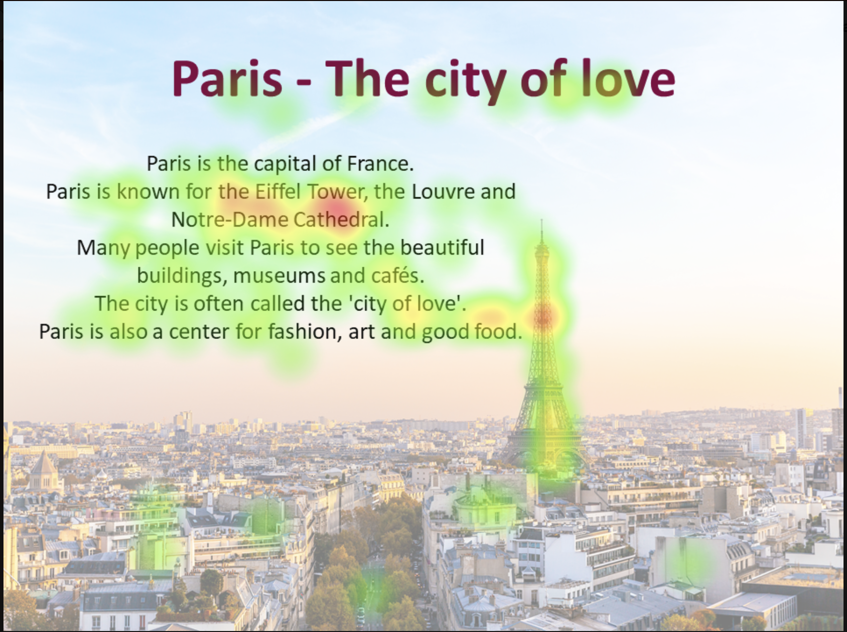
Heatmaps
In heat maps, gaze data captured by eye-tracking devices is superimposed on the original stimulus to create a combined view of both the stimulus and the participants’ gaze data.
Go back to the original slide
The visualisation shows coloured areas that represent fixations or saccades. The distribution of fixations, in which the participant remains relatively stable on an area of the stimulus, is indicated by the colouring from green to yellow to red. The redder and brighter the colours are, the longer this area is viewed.

Slide 9

Gaze video
In gaze video, gaze data collected from eye-tracking devices is superimposed onto the original stimulus, creating a combined view of both the stimulus and the participants’ eye movements.
Go back to the original slide
The visualisation includes dots representing fixations and lines representing saccades. Each dot indicating a moment when the participant’s gaze remains relatively stable on a specific area of the stimulus. The lines indicate rapid eye movements between two points.

Slide 10
Eye-Teach-Stats in Context
Eye-Teach-Stats is an Erasmus+ project supporting pre- and in-service mathematics teachers in recognising and responding to students’ systematic errors in statistical graph interpretation.
The course builds on eye-tracking research conducted by the project partners with primary and secondary school students, focusing on students’ conceptions and difficulties when interpreting and comparing statistical graphs (Abt et al., 2023, 2024, 2025; Boels et al., 2019a, 2019b, 2023, 2025; Schreiter & Vogel, 2022, 2023a, 2023b, 2024).
The training consists of five modules: eye-tracking information, dotplots, histograms, case-value plots, and boxplots, and is disseminated in English, German, and Dutch.
Project partners:
Heidelberg University of Education (lead), HU University of Applied Sciences Utrecht, KU Leuven, University of Education Freiburg, and University of Education Schwäbisch Gmünd.
More information: www.eye-teach-stats.eu

Slide 11














Project Team
Markus Vogel, Ayline Heursen
Saskia Schreiter
Wim Van Dooren
Lonneke Boels, Vuslat Şeker, Anita Alexander

Slide 12



Disclaimer & License
The ‘Eye-teach-stats’ project (2023-1-DE03-KA220-SCH-000158223) is funded by the European Union. Views and opinions expressed are, however, those of the authors only and do not necessarily reflect those of the European Union or the National Agency. Neither the European Union nor the granting authority can be held responsible for them.
Teaching Modules © 2026 by Eye-Teach-Stats Project is licensed under CC BY-SA 4.0. To view a copy of this license, visit creativecommons.org/licenses/by-sa/4.0/

Slide 13
References
Abt, M., Reinhold, F., & Van Dooren, W. (2023). Revealing cognitive processes when comparing box plots using eye-tracking data—A pilot study. In M. Ayalon, B. Koichu, R. Leikin, L. Rubel, & M. Tabach (Eds.), Proceedings of the 46th Conference of the International Group for the Psychology of Mathematics Education (Vol. 2, pp. 11–18). PME.
Abt, M., Leuders, T., Loibl, K., Strohmaier, A. R., Van Dooren, W., & Reinhold, F. (2024). How can eye-tracking data be used to understand cognitive processes when comparing data sets with box plots? Frontiers in Education, 9, Article 1425663. https://doi.org/10.3389/feduc.2024.1425663
Abt, M., Loibl, K., Leuders, T., Van Dooren, W., & Reinhold, F. (2025). Understanding student errors in comparing data sets with boxplots. Educational Studies in Mathematics, 120, 169–193. https://doi.org/10.1007/s10649-025-10387-z
Boels, L., Bakker, A., & Drijvers, P. (2019a). Eye tracking secondary school students’ strategies when interpreting statistical graphs. In M. Graven, H. Venkat, A. A. Essien, & P. Vale (Eds.), Proceedings of the Forty-Third Conference of the International Group for the Psychology of Mathematics Education (Vol. 2, pp. 113–120). PME.
Boels, L., Bakker, A., & Drijvers, P. (2019b). Unravelling teachers’ strategies when interpreting histograms: An eye-tracking study. In U. T. Jankvist, M. Van den Heuvel-Panhuizen, & M. Veldhuis (Eds.), Proceedings of the Eleventh Congress of the European Society for Research in Mathematics Education (pp. 888–895). Freudenthal Group & Freudenthal Institute, Utrecht University, and ERME.
Boels, L., Lyford, A., Bakker, A., & Drijvers, P. (2023). Assessing students’ interpretations of histograms before and after interpreting dotplots: A gaze-based machine learning analysis. Frontline Learning Research, 11(2), 1–30. https://doi.org/10.14786/flr.v11i2.1139
Boels, L., Bakker, A., Van Dooren, W., & Drijvers, P. (2025). Secondary school students’ strategies when interpreting histograms and case-value plots: An eye-tracking study. Educational Studies in Mathematics, 118(3), 479–503. https://doi.org/10.1007/s10649-024-10351-3
Schreiter, S., & Vogel, M. (2022). Drawing inference from data when comparing groups: An eye-tracking study. In C. Fernández, S. Llinares, A. Gutiérrez, & N. Planas (Eds.), Proceedings of the 45th Conference of the International Group for the Psychology of Mathematics Education (Vol. 4, p. 285). PME.
Schreiter, S., & Vogel, M. (2023a). Eye-tracking measures as indicators for a local vs. global view of data. Frontiers in Education, 7, Article 1058150. https://doi.org/10.3389/feduc.2022.1058150
Schreiter, S., & Vogel, M. (2023b). Statistical thinking and viewing patterns when comparing data distributions: An eye-tracking study with 6th and 8th graders. In M. Ayalon, B. Koichu, R. Leikin, L. Rubel, & M. Tabach (Eds.), Proceedings of the 46th Conference of the International Group for the Psychology of Mathematics Education (Vol. 4, pp. 179–186). PME.
Schreiter, S., & Vogel, M. (2024). Students’ local vs. global views of data distributions: A cross-grade-level analysis using eye-tracking. Educational Studies in Mathematics. https://doi.org/10.1007/s10649-024-10352-2
For a list of publications in the project, please click: https://eye-teach-stats.eu/publications/

