Slide 1

EYE TEACH STATS
Teaching Modules
Notes:
These modules were designed by: Ayline Heursen, Vuslat Șeker, Martin Abt, Anita Alexander, Frank Reinhold, Lonneke Boels, Wim Van Dooren, Saskia Schreiter and Markus Vogel.

Slide 2
Purpose
In this course you will learn to…
analyse students’ interpretations of statistical graphs.
recognise how students interpret different types of statistical graphs
recognise how these interpretations can lead to specific systematic errors.

Slide 3
The Course Journey
Access the vignettes
1) Sign into MaMpf
https://mampf.mathi.uni-heidelberg.de/
2) Subscribe to the course
https://mampf.mathi.uni-heidelberg.de/lectures/358

Slide 4
MODULE 2:
DOTPLOTS

Slide 5
Introduction
Analysing Student Interpretations
In this module, you will analyse how students interpret dotplots, using eye-tracking vignettes to examine how specific solution strategies can lead to systematic errors.

Slide 6
Eye-Tracking Vignettes
Eye tracking vignettes
The following eye-tracking vignettes present students’ interpretations of dotplots.
Access and complete the vignette activities below. Focus on how the student interprets the graph and which systematic errors may be present.
https://mampf.mathi.uni-heidelberg.de/lectures/358
01 Dotplot
06 Dotplot
10 Dotplot
11 Dotplot

Slide 7
Content Knowledge Recap
Refreshing Content Knowledge
For a short recap, see Dotplots Recap
It outlines key features of dotplots, including the distinction between local and global perspectives.
Notes:
These recap slides correspond to the supportive information provided in the vignettes. They are included here for teacher educators to use when content knowledge needs to be refreshed or discussed.

Slide 8
What have you worked on in this module?
In this module, you explored how students (mis)interpret dotplots. You worked with examples related to:
Systematic error | Definition
Frequency–value confusion | Incorrect estimation of the mean of frequencies instead of the mean value.
Overemphasising outlier | Judgement based on an outlier rather than on the distribution.
Pairwise stack comparison | Judgement based on comparing corresponding stacks/bars one by one, rather than on the distribution as a whole.
Sum for Mean: Sum of measured values | Data values are added up—multiplied by their frequencies—to draw conclusions about the distribution.
Notes:
Guiding questions for teacher educators:
What did you learn about students’ interpretations of dotplots through the eye-tracking vignette(s)?
Which systematic error is evident, and what observable behaviour in the vignette supports your interpretation?
What might this indicate about underlying conceptual difficulties?

Slide 9
PCK Recap: Understanding student error
This module focuses on how students interpret dotplot and what their systematic errors may reveal about underlying conceptual difficulties.
Students may
  Focus on individual dots, specific stacks, or extreme values or outliers.
  Overlook that stacked dots represent frequency at a given value
  Draw conclusions from local features rather than from the overall shape, centre, or spread
  Focus too much on global features only, such as the shape, rather than the values of the measurement.
This is closely related to the local–global distinction: students may correctly read individual values but struggle to use them to reason about the distribution.
Notes:
Key questions for discussion:
Is the student reasoning about individual data points, or about the distribution as a whole?
What would need to change in the student's thinking for them to move from a local to a global view?

Slide 10
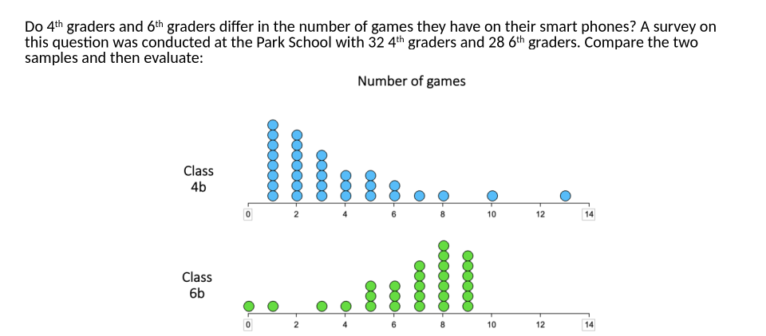
Discuss: Pairwise stack comparison
Look at the dotplots above. Consider a student who compares corresponding stacks one by one rather than reading the distributions as wholes. What conclusion might this student reach? Describe the gaze pattern you would expect, and consider whether this error is likely to occur with this particular graph.
Notes:
Teacher educator note:
Use this slide to open the discussion phase and to help participants move from identifying an incorrect answer to interpreting what the student may have attended to and how this may relate to an underlying conceptual difficulty.
Possible guiding questions:
What does this systematic error reveal about how the student may be interpreting the dotplot?
Which features of the graph does the student seem to use as evidence for their conclusion?
What might the student be overlooking when comparing the two distributions?
How could you support the student in moving from comparing individual stacks to comparing the distributions as wholes?

Slide 11
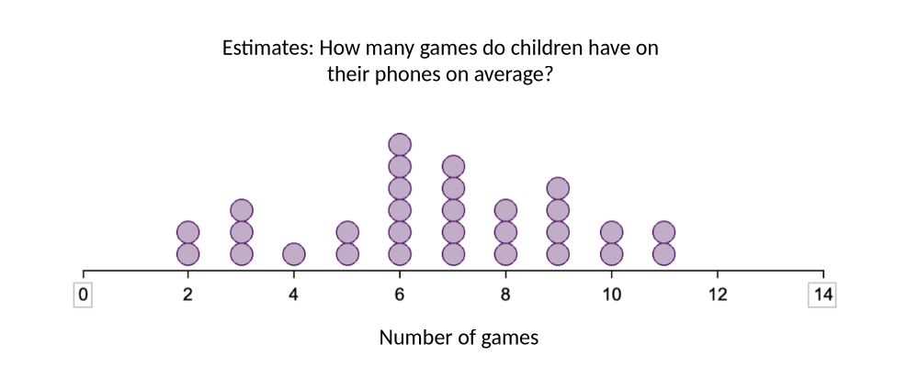
Discuss: Frequency-value confusion
Look at the task above. A student with frequency–value confusion would use the frequencies of the data points rather than the data values themselves to estimate the mean. Based on this, what answer would this student likely give? Describe the gaze pattern you would expect to see.
Notes:
Teacher educator note:
Focus the discussion on how gaze data can support or refine a hypothesis about frequency–value confusion. Encourage participants to connect the student’s answer, gaze pattern, and possible interpretation of the graph.
Possible guiding questions:
Which features of the dotplot might a student attend to when confusing frequency with data value?
What gaze pattern would support the hypothesis that the student is treating stack height as a value?
What question could you ask the student to find out how they understand the dots, stacks, and horizontal axis?

Slide 12
Knowledge Recap: Dotplots
Go back to the original slide
Notes:
Slide 54-55-56 - Dotplot

Slide 13
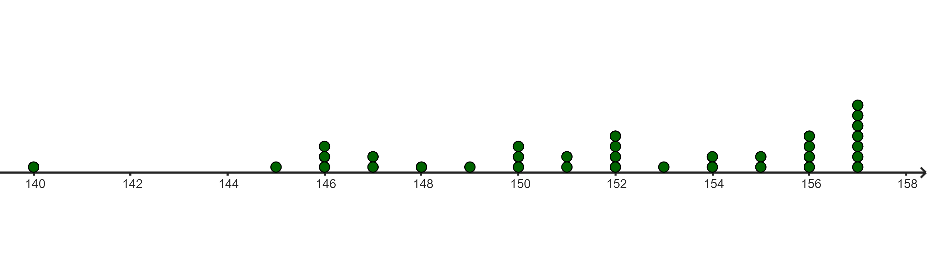
Content Knowledge Recap: Dotplots
Dotplots are graphical representations used to display the distribution of a dataset. In a dotplot, each data point is represented by a dot along a single axis, typically the horizontal axis. If multiple data points have the same value, their dots are stacked vertically. They are particularly useful for small to medium-sized datasets.
The height of children in class 5
stack
Go back to the original slide
data point
measured variable: height in cm
To compare distributions presented in dotplots, global features as well as local details can be taken into account.

Slide 14
Content Knowledge Recap: Dotplots
Perspectives on data distributions: Local vs. global views:
A central aim in statistics education is to guide students to develop also a “global view” of data distributions. In this perspective, students perceive distributions as conceptual entities with holistic features such as centre, spread, and shape. However, students frequently perceive distributions as mere collections of individual data points, leading them to focus excessively on local details of the distribution. This is called a “local view” of data distributions.
Global view | distribution (conceptual entity) |  |  | Local view
 | global features
 | center visually estimated mean … | spread/density observed spread-out-ness, majority, range… | shape observed skewness, peaks, tails…
 | local features individual data points extreme values, outlier, absolute frequency of dots in certain intervals, value of certain intervals of dots, disjoint edge values…
Go back to the original slide
Adapted according to Schreiter & Vogel, 2023

Slide 15
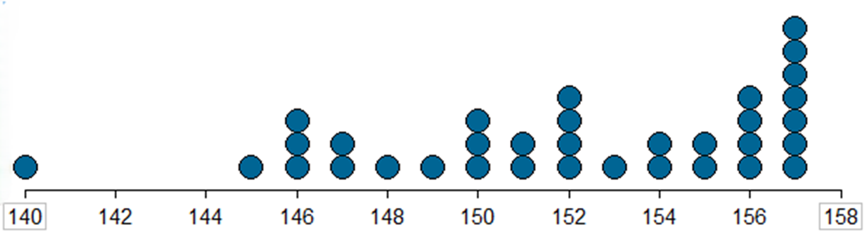
Content Knowledge Recap: Dotplots
To compare distributions presented in dotplots, global features (e.g., centre, spread/density, shape) as well as local features (e.g., outlier) can be taken into account.
The height (in cm) of children in class 5
center: mean
Go back to the original slide
Individual data point: outlier
shape
frequency of dots in certain interval
Spread / density: range

Slide 16
Eye-Teach-Stats in Context
Eye-Teach-Stats is an Erasmus+ project supporting pre- and in-service mathematics teachers in recognising and responding to students’ systematic errors in statistical graph interpretation.
The course builds on eye-tracking research conducted by the project partners with primary and secondary school students, focusing on students’ conceptions and difficulties when interpreting and comparing statistical graphs (Abt et al., 2023, 2024, 2025; Boels et al., 2019a, 2019b, 2023, 2025; Schreiter & Vogel, 2022, 2023a, 2023b, 2024).
The training consists of five modules: eye-tracking information, dotplots, histograms, case-value plots, and boxplots, and is disseminated in English, German, and Dutch.
Project partners:
Heidelberg University of Education (lead), HU University of Applied Sciences Utrecht, KU Leuven, University of Education Freiburg, and University of Education Schwäbisch Gmünd.
More information: www.eye-teach-stats.eu

Slide 17














Project Team
Markus Vogel, Ayline Heursen
Saskia Schreiter
Wim Van Dooren
Lonneke Boels, Vuslat Şeker, Anita Alexander

Slide 18



Disclaimer & License
The ‘Eye-teach-stats’ project (2023-1-DE03-KA220-SCH-000158223) is funded by the European Union. Views and opinions expressed are, however, those of the authors only and do not necessarily reflect those of the European Union or the National Agency. Neither the European Union nor the granting authority can be held responsible for them.
Teaching Modules © 2026 by Eye-Teach-Stats Project is licensed under CC BY-SA 4.0. To view a copy of this license, visit creativecommons.org/licenses/by-sa/4.0/

Slide 19
References
Abt, M., Reinhold, F., & Van Dooren, W. (2023). Revealing cognitive processes when comparing box plots using eye-tracking data—A pilot study. In M. Ayalon, B. Koichu, R. Leikin, L. Rubel, & M. Tabach (Eds.), Proceedings of the 46th Conference of the International Group for the Psychology of Mathematics Education (Vol. 2, pp. 11–18). PME.
Abt, M., Leuders, T., Loibl, K., Strohmaier, A. R., Van Dooren, W., & Reinhold, F. (2024). How can eye-tracking data be used to understand cognitive processes when comparing data sets with box plots? Frontiers in Education, 9, Article 1425663. https://doi.org/10.3389/feduc.2024.1425663
Abt, M., Loibl, K., Leuders, T., Van Dooren, W., & Reinhold, F. (2025). Understanding student errors in comparing data sets with boxplots. Educational Studies in Mathematics, 120, 169–193. https://doi.org/10.1007/s10649-025-10387-z
Boels, L., Bakker, A., & Drijvers, P. (2019a). Eye tracking secondary school students’ strategies when interpreting statistical graphs. In M. Graven, H. Venkat, A. A. Essien, & P. Vale (Eds.), Proceedings of the Forty-Third Conference of the International Group for the Psychology of Mathematics Education (Vol. 2, pp. 113–120). PME.
Boels, L., Bakker, A., & Drijvers, P. (2019b). Unravelling teachers’ strategies when interpreting histograms: An eye-tracking study. In U. T. Jankvist, M. Van den Heuvel-Panhuizen, & M. Veldhuis (Eds.), Proceedings of the Eleventh Congress of the European Society for Research in Mathematics Education (pp. 888–895). Freudenthal Group & Freudenthal Institute, Utrecht University, and ERME.
Boels, L., Lyford, A., Bakker, A., & Drijvers, P. (2023). Assessing students’ interpretations of histograms before and after interpreting dotplots: A gaze-based machine learning analysis. Frontline Learning Research, 11(2), 1–30. https://doi.org/10.14786/flr.v11i2.1139
Boels, L., Bakker, A., Van Dooren, W., & Drijvers, P. (2025). Secondary school students’ strategies when interpreting histograms and case-value plots: An eye-tracking study. Educational Studies in Mathematics, 118(3), 479–503. https://doi.org/10.1007/s10649-024-10351-3
Schreiter, S., & Vogel, M. (2022). Drawing inference from data when comparing groups: An eye-tracking study. In C. Fernández, S. Llinares, A. Gutiérrez, & N. Planas (Eds.), Proceedings of the 45th Conference of the International Group for the Psychology of Mathematics Education (Vol. 4, p. 285). PME.
Schreiter, S., & Vogel, M. (2023a). Eye-tracking measures as indicators for a local vs. global view of data. Frontiers in Education, 7, Article 1058150. https://doi.org/10.3389/feduc.2022.1058150
Schreiter, S., & Vogel, M. (2023b). Statistical thinking and viewing patterns when comparing data distributions: An eye-tracking study with 6th and 8th graders. In M. Ayalon, B. Koichu, R. Leikin, L. Rubel, & M. Tabach (Eds.), Proceedings of the 46th Conference of the International Group for the Psychology of Mathematics Education (Vol. 4, pp. 179–186). PME.
Schreiter, S., & Vogel, M. (2024). Students’ local vs. global views of data distributions: A cross-grade-level analysis using eye-tracking. Educational Studies in Mathematics. https://doi.org/10.1007/s10649-024-10352-2
For a list of publications in the project, please click: https://eye-teach-stats.eu/publications/

