Slide 1

EYE TEACH STATS
Teaching Modules
Notes:
These modules were designed by: Ayline Heursen, Vuslat Șeker, Martin Abt, Anita Alexander, Frank Reinhold, Lonneke Boels, Wim Van Dooren, Saskia Schreiter and Markus Vogel.

Slide 2
Purpose
In this course you will learn to…
analyse students’ interpretations of statistical graphs.
recognise how students interpret different types of statistical graphs
recognise how these interpretations can lead to specific systematic errors.

Slide 3
The Course Journey
Access the vignettes
1) Sign into MaMpf
https://mampf.mathi.uni-heidelberg.de/
2) Subscribe to the course
https://mampf.mathi.uni-heidelberg.de/lectures/358

Slide 4
MODULE 3:
HISTOGRAM

Slide 5
Introduction
Analysing Student Interpretations
In this module, you will analyse how students interpret histograms, using eye-tracking vignettes to examine how specific solution strategies can lead to systematic errors.

Slide 6
Histogram: Eye-Tracking Vignettes
Eye tracking vignettes
The following eye-tracking vignettes present students’ interpretations of histograms.
Access and complete the vignette activities below. Focus on how the student interprets the graph and which systematic errors may be present.
https://mampf.mathi.uni-heidelberg.de/lectures/358
07 Histogram
09 Histogram
12 Histogram
13 Histogram
17 Histogram
19 Histogram

Slide 7
Content Knowledge Recap
Refreshing Content Knowledge
For a short recap, see the Histograms Recap
It outlines the key features of histograms.
Notes:
These recap slides correspond to the supportive information provided in the vignettes. They are included here for teacher educators to use when content knowledge needs to be refreshed or discussed.

Slide 8
What have you worked on in this module?
In this module, you explored how students (mis)interpret histograms. You worked with examples related to:
Systematic error | Definition
Frequency–value confusion | Incorrect estimation of the mean of frequencies instead of the mean value.
Sum for mean: Sum of frequencies | Frequencies are added up to draw conclusions about statistical concepts or the overall data distribution.
Pairwise stack comparison | Judgement based on comparing corresponding stacks/bars one by one, rather than on the distribution as a whole.
Overemphasising number of bars | Judgement based on the number of bars rather than on the distribution.

Slide 9
PCK Recap: Understanding Student Error
This module focuses on how students interpret histogram and what their systematic errors may reveal about underlying conceptual difficulties.
Students may:
  Treat bar heights as measured values rather than frequencies
  Add up frequencies instead of reasoning about the mean as a balance point
  Fail to integrate local and global features (e.g., bar positions vs. overall shape), overemphasising one at the expense of the other
  Overlook that the mean is located on the horizontal axis, not the vertical axis.
A key conceptual difficulty: students may not yet understand that the mean in a histogram is a property of the distribution, not a value that can be read directly from a single bar.
Notes:
Key questions for discussion:
What does the student think the bar height represents — a frequency or a data value?
How does the student's error relate to their understanding of the mean as a balance point of the distribution?

Slide 10
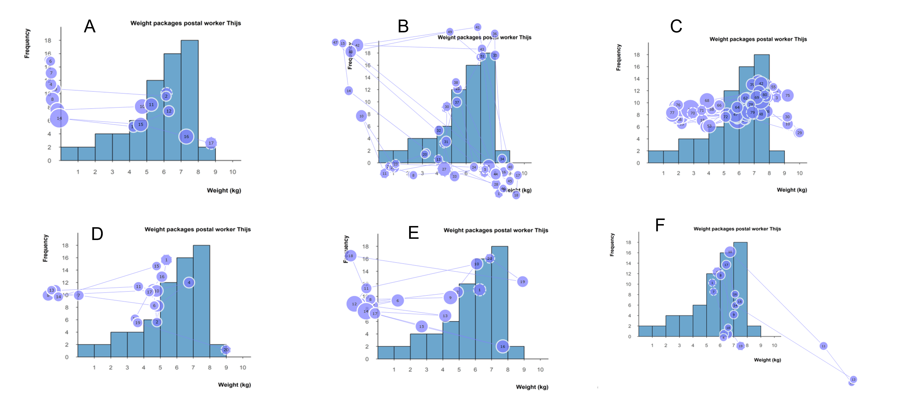
Discuss: Frequency-value confusion
Given the gaze plots of six students for the same item, identify which students are likely to make a frequency-value confusion systematic error. Please provide detailed reasons why you have a) opted for a student
[xy], and b) decided against the other students.
Notes:
Teacher educator note:
This task asks participants to identify possible frequency–value confusion from several gaze plots. Focus the discussion on the evidence used for classification and on the limits of what can be inferred from gaze data alone.
Possible guiding questions:
Which gaze patterns provide evidence for frequency–value confusion in this histogram task?
Which students were more difficult to classify, and what made the gaze evidence less clear?
How could the student’s answer or explanation strengthen or change your interpretation of the gaze data?
What might it suggest for instruction if several students show similar gaze patterns on the same task?

Slide 11
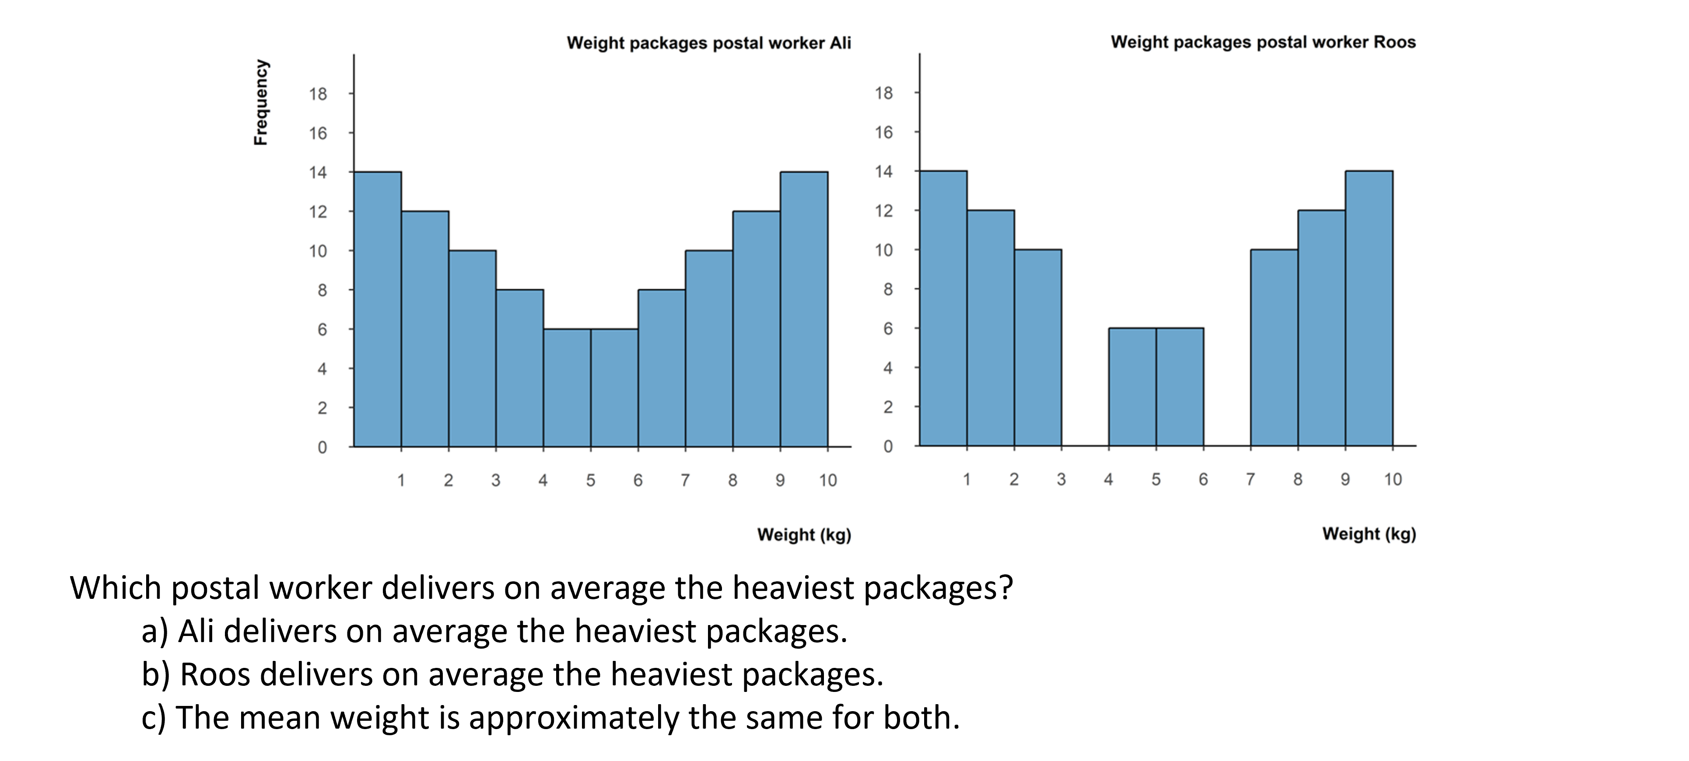
Discuss: Overemphasising the number of bars
Look at the histogram above. Consider a student who bases their judgement on the number of bars rather than on the distribution. What conclusion might this student reach? Describe the gaze pattern you would expect, and consider whether this error is likely to occur with this particular graph.
Notes:
Teacher educator note:
Focus on how students may rely on a visible and countable feature of the histogram—the number of bars—rather than reasoning about the measured values, frequencies, and the distribution as a whole.
Possible guiding questions:
Why might the number of visible bars be a salient feature for students in this task?
What might a student overlook if they base their judgement mainly on the number of bars?
What gaze pattern would support the hypothesis that the student is focusing on the number of bars?
What follow-up question could help the student attend to the position of the bars and the overall distribution?

Slide 12
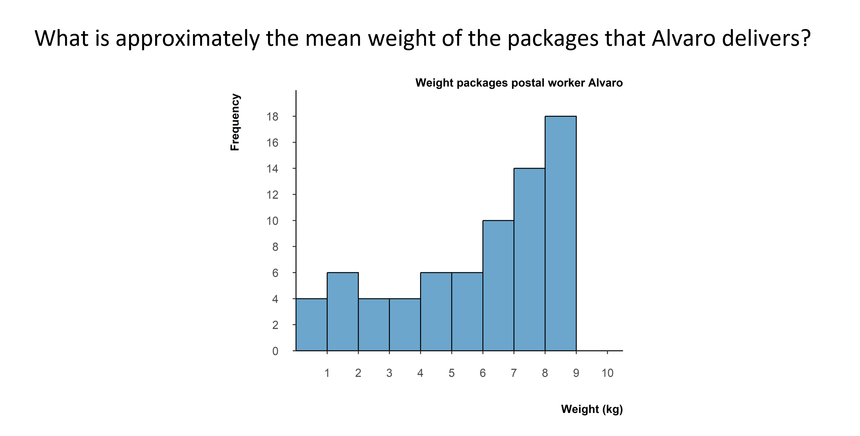
Discuss: Sum for mean: Sum of frequencies
Look at the histogram below. Consider a student who adds up the frequencies and dividing number of bars rather than estimating the mean of the data values. What answer might this student give? Describe the gaze pattern you would expect, and consider whether this error is likely to occur with this particular graph.
Notes:
Teacher educator note:
Use this slide to distinguish the sum of frequencies error from other histogram errors. Focus on what the student may be treating as data and how the gaze pattern can provide evidence for this interpretation.
Possible guiding questions:
What does the sum of frequencies error suggest about what the student treats as the data in a histogram?
How is this error related to, but different from, frequency–value confusion?
What gaze pattern would you expect from a student who adds frequencies and divides by the number of bars?
What follow-up task or question could help you distinguish between frequency–value confusion and sum of frequencies?

Slide 13
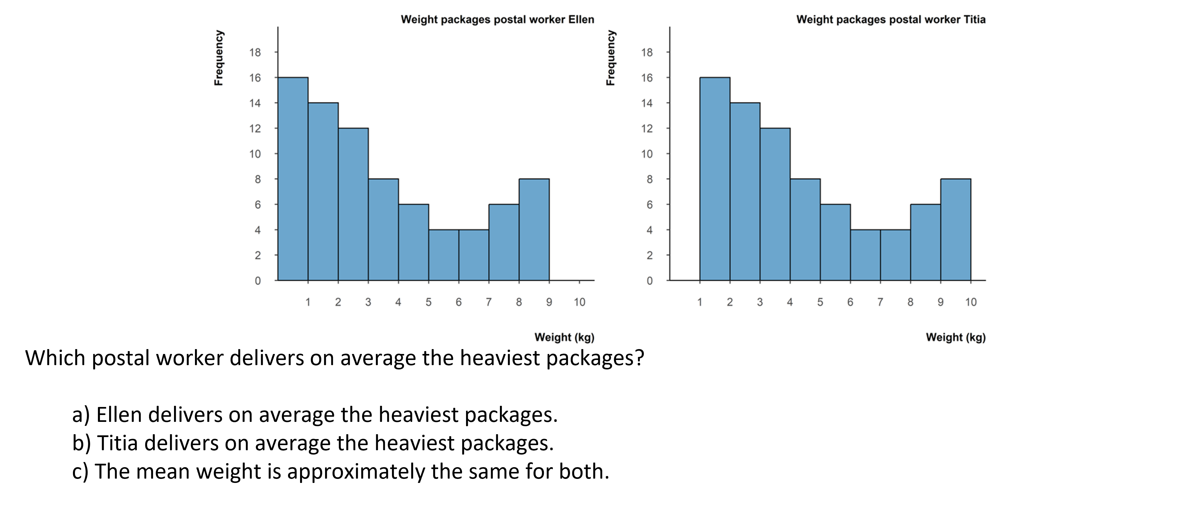
Discuss: Pairwise stack comparison
Look at the histograms above. Consider a student who compares individual bars one by one rather than reading the distribution as a whole. What conclusion might this student reach? Describe the gaze pattern you would expect, and consider whether this error is likely to occur with this particular graph.
Notes:
Teacher educator note:
Focus on the student’s local, bar-by-bar comparison of two histograms. Use the discussion to contrast comparing individual bars with interpreting the overall distribution, including centre, shift, spread, and shape.
Possible guiding questions:
What might pairwise stack comparison reveal about how the student compares the two histograms?
Which global features of the distributions might the student be overlooking?
What gaze pattern would support the hypothesis that the student is comparing bars pairwise?
How could you prompt the student to compare the distributions as wholes rather than focusing only on corresponding bars?

Slide 14
Knowledge Recap: Histogram
Go back to the original slide
Notes:
Slide 58-59 Histogram

Slide 15
Content Knowledge Recap: Histogram
A histogram is a graph with bars that meets the following criteria:
• It consists of bars that represent grouped numerical data.
• It represents data of one statistical variable only (typically continuous).
• The statistical variable is presented conventionally on the horizontal axis.
• The statistical variable is measured at an interval or ratio measurement level.
• The vertical axis displays the class density, or—when bin widths are equal—relative or absolute frequency (counts) of the depicted statistical variable.
• The total density adds up to 1 or the total relative frequency adds up to 100%.
Go back to the original slide

Slide 16
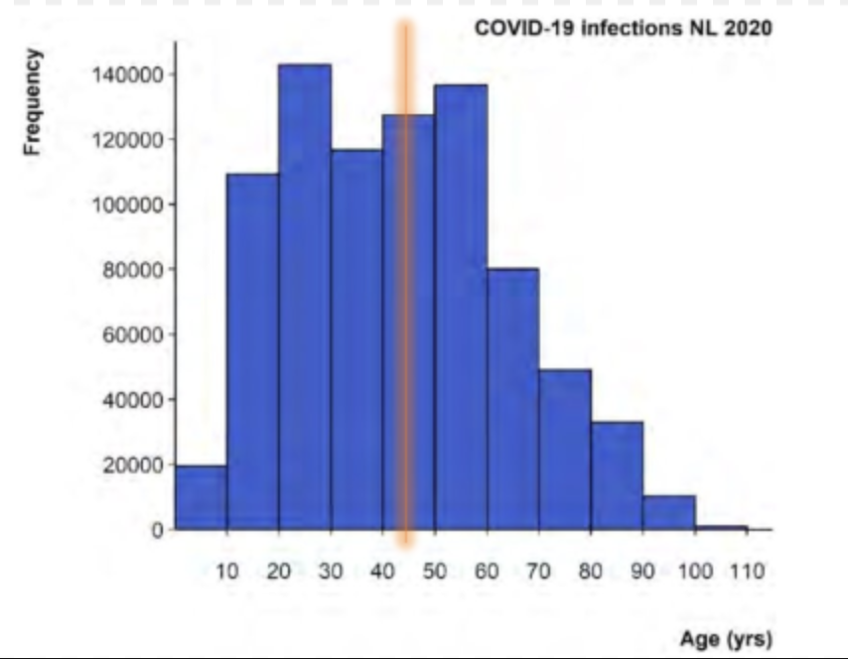
Content Knowledge Recap: Histogram
Go back to the original slide
How to analyse and interpret a histogram:
The mean age (roughly 43 years) is along the horizontal axis and can be depicted by a vertical line that crosses the horizontal axis at 43 years; the balance point of the graph.
This can also be estimated by multiplying the midrange of each bin by the height of the bar, summing these products, and then dividing by the sum of the frequencies.

Slide 17
Eye-Teach-Stats in Context
Eye-Teach-Stats is an Erasmus+ project supporting pre- and in-service mathematics teachers in recognising and responding to students’ systematic errors in statistical graph interpretation.
The course builds on eye-tracking research conducted by the project partners with primary and secondary school students, focusing on students’ conceptions and difficulties when interpreting and comparing statistical graphs (Abt et al., 2023, 2024, 2025; Boels et al., 2019a, 2019b, 2023, 2025; Schreiter & Vogel, 2022, 2023a, 2023b, 2024).
The training consists of five modules: eye-tracking information, dotplots, histograms, case-value plots, and boxplots, and is disseminated in English, German, and Dutch.
Project partners:
Heidelberg University of Education (lead), HU University of Applied Sciences Utrecht, KU Leuven, University of Education Freiburg, and University of Education Schwäbisch Gmünd.
More information: www.eye-teach-stats.eu

Slide 18














Project Team
Markus Vogel, Ayline Heursen
Saskia Schreiter
Wim Van Dooren
Lonneke Boels, Vuslat Şeker, Anita Alexander

Slide 19



Disclaimer & License
The ‘Eye-teach-stats’ project (2023-1-DE03-KA220-SCH-000158223) is funded by the European Union. Views and opinions expressed are, however, those of the authors only and do not necessarily reflect those of the European Union or the National Agency. Neither the European Union nor the granting authority can be held responsible for them.
Teaching Modules © 2026 by Eye-Teach-Stats Project is licensed under CC BY-SA 4.0. To view a copy of this license, visit creativecommons.org/licenses/by-sa/4.0/

Slide 20
References
Abt, M., Reinhold, F., & Van Dooren, W. (2023). Revealing cognitive processes when comparing box plots using eye-tracking data—A pilot study. In M. Ayalon, B. Koichu, R. Leikin, L. Rubel, & M. Tabach (Eds.), Proceedings of the 46th Conference of the International Group for the Psychology of Mathematics Education (Vol. 2, pp. 11–18). PME.
Abt, M., Leuders, T., Loibl, K., Strohmaier, A. R., Van Dooren, W., & Reinhold, F. (2024). How can eye-tracking data be used to understand cognitive processes when comparing data sets with box plots? Frontiers in Education, 9, Article 1425663. https://doi.org/10.3389/feduc.2024.1425663
Abt, M., Loibl, K., Leuders, T., Van Dooren, W., & Reinhold, F. (2025). Understanding student errors in comparing data sets with boxplots. Educational Studies in Mathematics, 120, 169–193. https://doi.org/10.1007/s10649-025-10387-z
Boels, L., Bakker, A., & Drijvers, P. (2019a). Eye tracking secondary school students’ strategies when interpreting statistical graphs. In M. Graven, H. Venkat, A. A. Essien, & P. Vale (Eds.), Proceedings of the Forty-Third Conference of the International Group for the Psychology of Mathematics Education (Vol. 2, pp. 113–120). PME.
Boels, L., Bakker, A., & Drijvers, P. (2019b). Unravelling teachers’ strategies when interpreting histograms: An eye-tracking study. In U. T. Jankvist, M. Van den Heuvel-Panhuizen, & M. Veldhuis (Eds.), Proceedings of the Eleventh Congress of the European Society for Research in Mathematics Education (pp. 888–895). Freudenthal Group & Freudenthal Institute, Utrecht University, and ERME.
Boels, L., Lyford, A., Bakker, A., & Drijvers, P. (2023). Assessing students’ interpretations of histograms before and after interpreting dotplots: A gaze-based machine learning analysis. Frontline Learning Research, 11(2), 1–30. https://doi.org/10.14786/flr.v11i2.1139
Boels, L., Bakker, A., Van Dooren, W., & Drijvers, P. (2025). Secondary school students’ strategies when interpreting histograms and case-value plots: An eye-tracking study. Educational Studies in Mathematics, 118(3), 479–503. https://doi.org/10.1007/s10649-024-10351-3
Schreiter, S., & Vogel, M. (2022). Drawing inference from data when comparing groups: An eye-tracking study. In C. Fernández, S. Llinares, A. Gutiérrez, & N. Planas (Eds.), Proceedings of the 45th Conference of the International Group for the Psychology of Mathematics Education (Vol. 4, p. 285). PME.
Schreiter, S., & Vogel, M. (2023a). Eye-tracking measures as indicators for a local vs. global view of data. Frontiers in Education, 7, Article 1058150. https://doi.org/10.3389/feduc.2022.1058150
Schreiter, S., & Vogel, M. (2023b). Statistical thinking and viewing patterns when comparing data distributions: An eye-tracking study with 6th and 8th graders. In M. Ayalon, B. Koichu, R. Leikin, L. Rubel, & M. Tabach (Eds.), Proceedings of the 46th Conference of the International Group for the Psychology of Mathematics Education (Vol. 4, pp. 179–186). PME.
Schreiter, S., & Vogel, M. (2024). Students’ local vs. global views of data distributions: A cross-grade-level analysis using eye-tracking. Educational Studies in Mathematics. https://doi.org/10.1007/s10649-024-10352-2
For a list of publications in the project, please click: https://eye-teach-stats.eu/publications/

