Slide 1

EYE TEACH STATS
Teaching Modules
Notes:
These modules were designed by: Ayline Heursen, Vuslat Șeker, Martin Abt, Anita Alexander, Frank Reinhold, Lonneke Boels, Wim Van Dooren, Saskia Schreiter and Markus Vogel.

Slide 2
Purpose
In this course you will learn to…
analyse students’ interpretations of statistical graphs.
recognise how students interpret different types of statistical graphs
recognise how these interpretations can lead to specific systematic errors.

Slide 3
The Course Journey
Access the vignettes
1) Sign into MaMpf
https://mampf.mathi.uni-heidelberg.de/
2) Subscribe to the course
https://mampf.mathi.uni-heidelberg.de/lectures/358

Slide 4
MODULE 4:
CASE-VALUE PLOTS

Slide 5
Introduction
Analysing Student Interpretations
In this module, you will analyse how students interpret case-value plots, using eye-tracking vignettes to examine how specific solution strategies can lead to systematic errors.

Slide 6
Eye-Tracking Vignettes
Vignette Activities
The following eye-tracking vignettes present students’ interpretations of case-value plots.
Access and complete the vignette activities below.
Focus on how the student interprets the graph and which systematic errors may be present.
https://mampf.mathi.uni-heidelberg.de/lectures/358
04 Case-value plots
05 Case-value plots
08 Case-value plots
18 Case-value plots

Slide 7
Content Knowledge Recap
Refreshing Content Knowledge
For a short recap, see Case-value plots Recap.
It outlines key features of case-value plots, including how to distinguish case-value plots from histograms.
Notes:
These recap slides correspond to the supportive information provided in the vignettes. They are included here for teacher educators to use when content knowledge needs to be refreshed or discussed.

Slide 8
What have you worked on in this module?
In this module, you explored how students (mis)interpret case-value plots. You worked with examples related to:
Systematic error | Definition
Overgeneralisation of a histogram approach | Incorrect assumption that a case-value plot can be interpreted like a histogram, based on shape or balance rather than on individual measured values.
Pairwise stack comparison | Judgement based on comparing corresponding stacks/bars one by one, rather than on the distribution as a whole.

Slide 9
PCK Recap: Understanding student error
This module focuses on how students interpret case-value plots and what their systematic errors may reveal about underlying conceptual difficulties.
Students may:
  Apply a histogram-reading strategy, interpreting bar heights as frequencies
  Compare visible bars pairwise without considering the full set of values
  Overlook zero bars, which represent cases with a measured value of zero
  Focus on visual patterns or symmetry instead of reasoning about individual measured values
  A key conceptual difficulty: students may not yet understand that each bar in a case-value plot represents one individual measured value — and that all values, including zeros, contribute to the mean.
Notes:
Key questions for discussion:
What does the student think each bar represents — a frequency or a measured value?
How does the student's approach change when zero values are present in the graph?

Slide 10
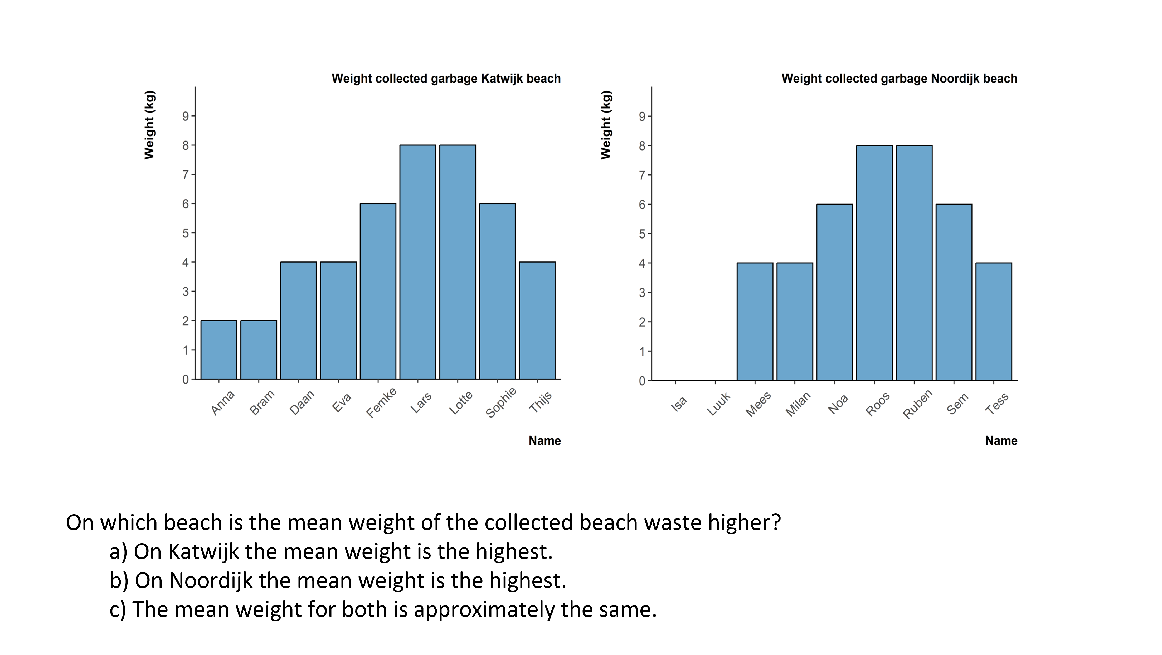
Discuss: Pairwise stack comparison
Look at the case-value plot above. Consider a student who bases their comparison mainly on the visible bars.
What conclusion might this student reach? Describe the gaze pattern you would expect, and consider which measured values the student might take into account or overlook.
Notes:
Teacher educator note:
Use this slide to discuss how students may compare visible bars in case-value plots without taking all measured values into account. In particular, focus on whether zero values are noticed and included in reasoning about the mean.
Possible guiding questions:
Which bars or values does the student seem to take into account when comparing the two case-value plots?
Does the student appear to include zero values as measured values? What evidence supports your interpretation?
What gaze pattern would you expect from a student who mainly compares visible non-zero bars?
How could you help the student recognise that each case, including a zero value, contributes to the mean?

Slide 11
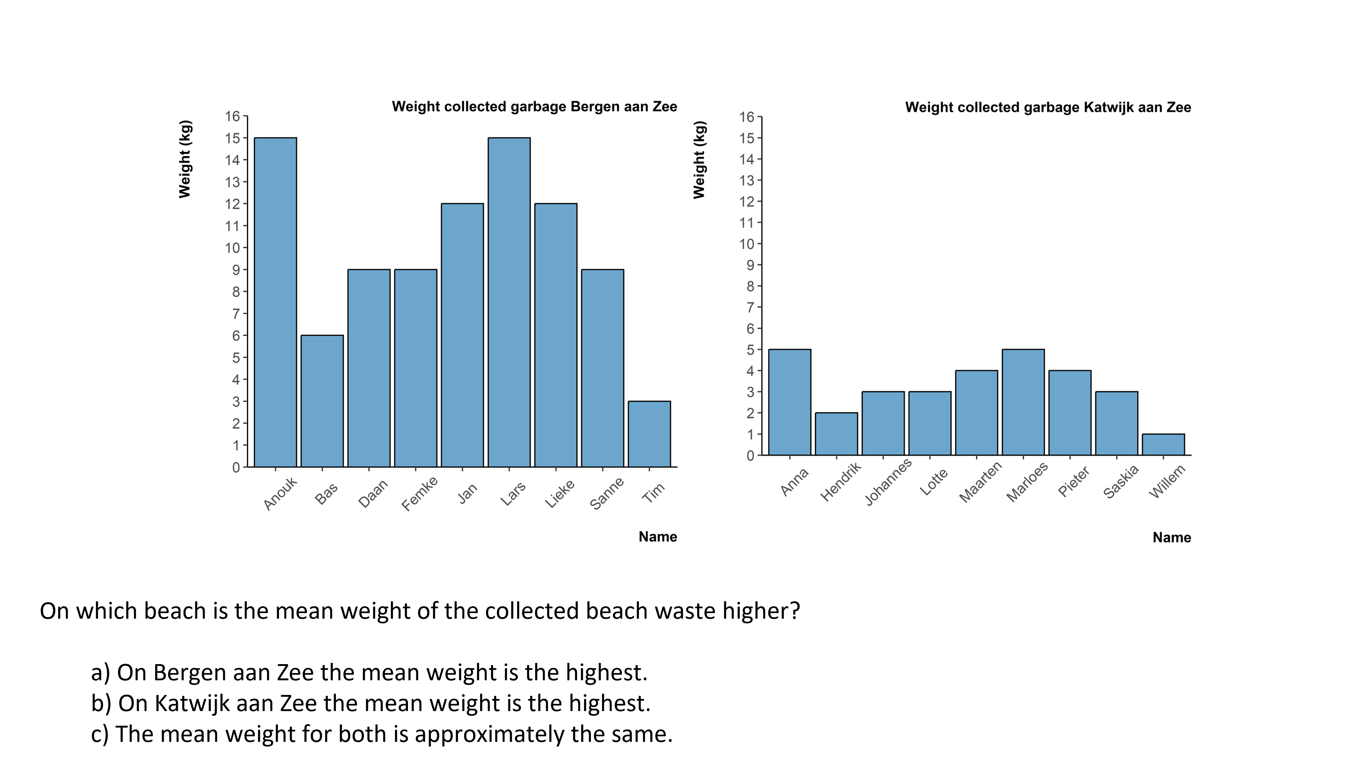
Discuss: Overgeneralisation of a histogram approach
Look at the case-value plot below. Consider a student who shows overgeneralisation of a histogram approach when interpreting this graph, for example by focusing on the visual pattern of the bars rather than on the individual measured values.
What conclusion might this student reach? Describe the gaze pattern you would expect, and consider whether this systematic error is likely to occur with this particular graph.
Notes:
Teacher educator note:
This discussion focuses on the inappropriate transfer of a histogram approach to case-value plots. Encourage participants to identify what the student may be assuming about bar height, visual pattern, and mean.
Possible guiding questions:
What might this error reveal about how the student interprets bar-like graphs?
Which aspects of the case-value plot might invite a histogram-like interpretation?
What gaze pattern would support the hypothesis that the student is focusing on visual pattern, symmetry, or balance?
How could you make the difference between histograms and case-value plots explicit in a classroom conversation?

Slide 12
Knowledge Recap: Case-value Plots
Go back to the original slide
Notes:
Slide 62-63

Slide 13
Content Knowledge Recap: Case-value Plots
A Case-Value Plot (CVP) is another type of graph with bars in which each bar’s height represents one measured value. In a case-value plot with nominal data on the horizontal axis and numerical data on the vertical axis (two measured variables), the relevant measured value is on the vertical axis and variability can be seen as variation in the heights of the bars.
Why do we use CVPs?
To visually compare measurements of nominal data
Comparing means of categories [=nominal data] by case
To see the variations between individual measurements
Go back to the original slide

Slide 14
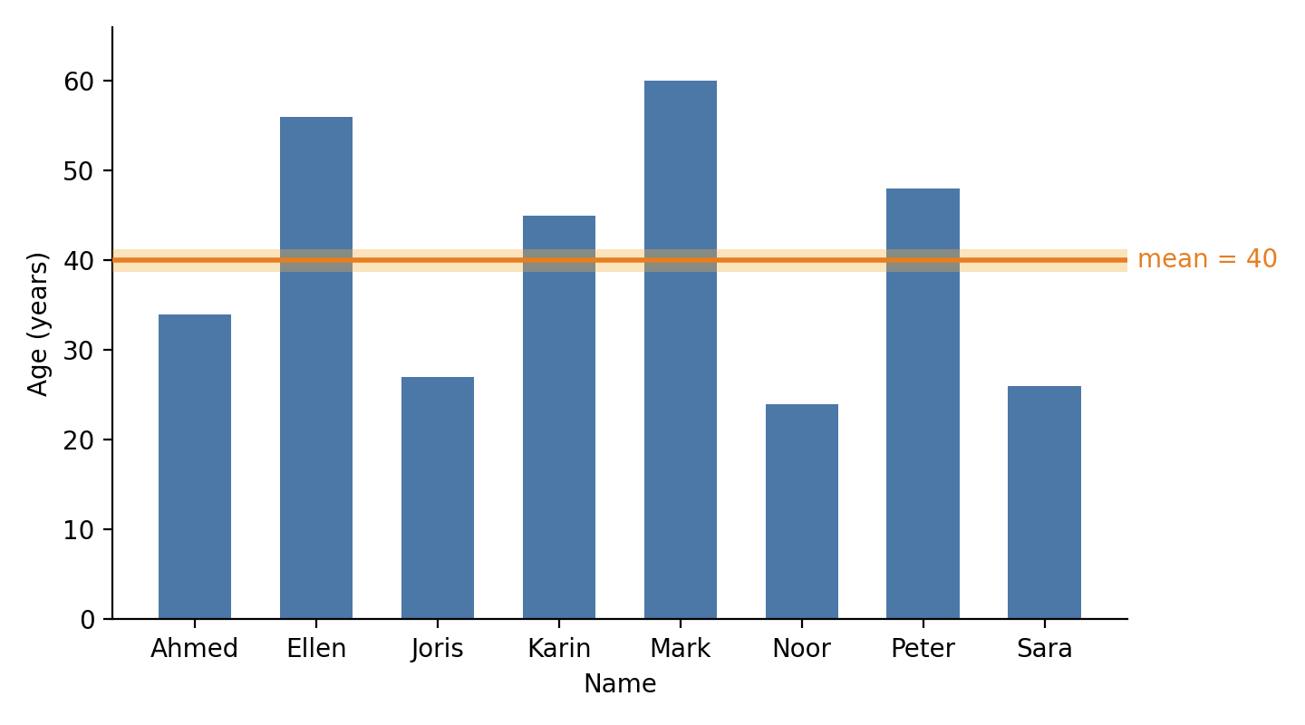
Content Knowledge Recap: Case-value Plots
Example:
This case-value plot depicts the ages of the eight teachers in the mathematics department of a school. Each bar represents one teacher.
The mean age can be depicted by a horizontal line at 40 years, crossing the vertical axis at that number.
For the mean, the empty (white) space between the line and the shorter bars is exactly as large as the parts of the taller bars that rise above the line. If you moved the parts above the line into the gaps below it, all bars would become equally high.
Go back to the original slide

Slide 15
Eye-Teach-Stats in Context
Eye-Teach-Stats is an Erasmus+ project supporting pre- and in-service mathematics teachers in recognising and responding to students’ systematic errors in statistical graph interpretation.
The course builds on eye-tracking research conducted by the project partners with primary and secondary school students, focusing on students’ conceptions and difficulties when interpreting and comparing statistical graphs (Abt et al., 2023, 2024, 2025; Boels et al., 2019a, 2019b, 2023, 2025; Schreiter & Vogel, 2022, 2023a, 2023b, 2024).
The training consists of five modules: eye-tracking information, dotplots, histograms, case-value plots, and boxplots, and is disseminated in English, German, and Dutch.
Project partners:
Heidelberg University of Education (lead), HU University of Applied Sciences Utrecht, KU Leuven, University of Education Freiburg, and University of Education Schwäbisch Gmünd.
More information: www.eye-teach-stats.eu

Slide 16














Project Team
Markus Vogel, Ayline Heursen
Saskia Schreiter
Wim Van Dooren
Lonneke Boels, Vuslat Şeker, Anita Alexander

Slide 17



Disclaimer & License
The ‘Eye-teach-stats’ project (2023-1-DE03-KA220-SCH-000158223) is funded by the European Union. Views and opinions expressed are, however, those of the authors only and do not necessarily reflect those of the European Union or the National Agency. Neither the European Union nor the granting authority can be held responsible for them.
Teaching Modules © 2026 by Eye-Teach-Stats Project is licensed under CC BY-SA 4.0. To view a copy of this license, visit creativecommons.org/licenses/by-sa/4.0/

Slide 18
References
Abt, M., Reinhold, F., & Van Dooren, W. (2023). Revealing cognitive processes when comparing box plots using eye-tracking data—A pilot study. In M. Ayalon, B. Koichu, R. Leikin, L. Rubel, & M. Tabach (Eds.), Proceedings of the 46th Conference of the International Group for the Psychology of Mathematics Education (Vol. 2, pp. 11–18). PME.
Abt, M., Leuders, T., Loibl, K., Strohmaier, A. R., Van Dooren, W., & Reinhold, F. (2024). How can eye-tracking data be used to understand cognitive processes when comparing data sets with box plots? Frontiers in Education, 9, Article 1425663. https://doi.org/10.3389/feduc.2024.1425663
Abt, M., Loibl, K., Leuders, T., Van Dooren, W., & Reinhold, F. (2025). Understanding student errors in comparing data sets with boxplots. Educational Studies in Mathematics, 120, 169–193. https://doi.org/10.1007/s10649-025-10387-z
Boels, L., Bakker, A., & Drijvers, P. (2019a). Eye tracking secondary school students’ strategies when interpreting statistical graphs. In M. Graven, H. Venkat, A. A. Essien, & P. Vale (Eds.), Proceedings of the Forty-Third Conference of the International Group for the Psychology of Mathematics Education (Vol. 2, pp. 113–120). PME.
Boels, L., Bakker, A., & Drijvers, P. (2019b). Unravelling teachers’ strategies when interpreting histograms: An eye-tracking study. In U. T. Jankvist, M. Van den Heuvel-Panhuizen, & M. Veldhuis (Eds.), Proceedings of the Eleventh Congress of the European Society for Research in Mathematics Education (pp. 888–895). Freudenthal Group & Freudenthal Institute, Utrecht University, and ERME.
Boels, L., Lyford, A., Bakker, A., & Drijvers, P. (2023). Assessing students’ interpretations of histograms before and after interpreting dotplots: A gaze-based machine learning analysis. Frontline Learning Research, 11(2), 1–30. https://doi.org/10.14786/flr.v11i2.1139
Boels, L., Bakker, A., Van Dooren, W., & Drijvers, P. (2025). Secondary school students’ strategies when interpreting histograms and case-value plots: An eye-tracking study. Educational Studies in Mathematics, 118(3), 479–503. https://doi.org/10.1007/s10649-024-10351-3
Schreiter, S., & Vogel, M. (2022). Drawing inference from data when comparing groups: An eye-tracking study. In C. Fernández, S. Llinares, A. Gutiérrez, & N. Planas (Eds.), Proceedings of the 45th Conference of the International Group for the Psychology of Mathematics Education (Vol. 4, p. 285). PME.
Schreiter, S., & Vogel, M. (2023a). Eye-tracking measures as indicators for a local vs. global view of data. Frontiers in Education, 7, Article 1058150. https://doi.org/10.3389/feduc.2022.1058150
Schreiter, S., & Vogel, M. (2023b). Statistical thinking and viewing patterns when comparing data distributions: An eye-tracking study with 6th and 8th graders. In M. Ayalon, B. Koichu, R. Leikin, L. Rubel, & M. Tabach (Eds.), Proceedings of the 46th Conference of the International Group for the Psychology of Mathematics Education (Vol. 4, pp. 179–186). PME.
Schreiter, S., & Vogel, M. (2024). Students’ local vs. global views of data distributions: A cross-grade-level analysis using eye-tracking. Educational Studies in Mathematics. https://doi.org/10.1007/s10649-024-10352-2
For a list of publications in the project, please click: https://eye-teach-stats.eu/publications/

