Slide 1

EYE TEACH STATS
Teaching Modules
Notes:
These modules were designed by: Ayline Heursen, Vuslat Șeker, Martin Abt, Anita Alexander, Frank Reinhold, Lonneke Boels, Wim Van Dooren, Saskia Schreiter and Markus Vogel.

Slide 2
Purpose
In this course you will learn to…
analyse students’ interpretations of statistical graphs.
recognise how students interpret different types of statistical graphs
recognise how these interpretations can lead to specific systematic errors.

Slide 3
The Course Journey
Access the vignettes
1) Sign into MaMpf
https://mampf.mathi.uni-heidelberg.de/
2) Subscribe to the course
https://mampf.mathi.uni-heidelberg.de/lectures/358

Slide 4
MODULE 5:
BOXPLOTS

Slide 5
Introduction
Analysing Student Interpretations
In this module, you will analyse how students interpret boxplots, using eye-tracking vignettes to examine how specific solution strategies can lead to systematic errors.

Slide 6
Boxplot: Eye-Tracking Vignettes
Vignette Activities
The following eye-tracking vignettes present students’ interpretations of boxplots.
Access and complete the vignette activities below. Focus on how the student interprets the graph and which systematic errors may be present.
https://mampf.mathi.uni-heidelberg.de/lectures/358
02 Boxplot
03 Boxplot
14 Boxplot
15 Boxplot
16 Boxplot

Slide 7
Content Knowledge Recap
Refreshing Content Knowledge
For a short recap, see Boxplot Recap.
It outlines key features of boxplots, including acquiring conceptual knowledge on variability.
Notes:
These recap slides correspond to the supportive information provided in the vignettes. They are included here for teacher educators to use when content knowledge needs to be refreshed or discussed.

Slide 8
What have you worked on in this module?
In this module, you explored how students (mis)interpret boxplots. You worked with examples related to:
Systematic error | Definition
Median bias | Judgement based on an incorrect measure of central tendency.
Area bias | Incorrect assumption that a longer box represents a higher frequency of observations.

Slide 9
PCK Recap: Understanding student error
This module focuses on how students interpret boxplotand what their systematic errors may reveal about underlying conceptual difficulties.
Students may:
  Overgeneralise the median as the only relevant measure for every question
  Interpret a longer or larger box as representing more observations
            Focus on area or length rather than on the boundaries the box represents
              Overlook that quartiles divide the data into equal proportions, not equal intervals
A key conceptual difficulty: students may interpret visual size as representing frequency, rather than understanding that each section of the boxplot represents the same proportion of the data.
Notes:
Key questions for discussion:
Which element of the boxplot does the student rely on, and does it match what that element actually represents?
Does the student understand that each section of the boxplot represents the same proportion of the data, regardless of its visual size?

Slide 10
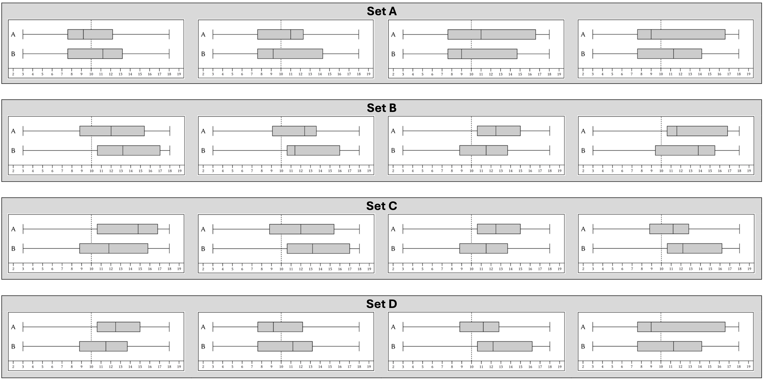
Discuss: Median bias
Suppose you suspect that one of your students makes systematic error median bias. Which of the following item sets would you let your student solve so that you are sure? Please provide detailed reasons why you have
opted for item set
decided against the other item sets.
Notes:
Teacher educator note:
This task shifts the discussion from identifying an error to selecting items that can reveal a conceptual difficulty. Use it to discuss what makes a task informative for diagnosing median bias.
Possible guiding questions:
What should an item set make visible if you want to investigate median bias?
What answer would you expect from a student who relies mainly on the median, and why?
Why is one item set more informative than the others for this specific conceptual difficulty?
How does choosing a follow-up item help you learn more about the student’s understanding of boxplots?

Slide 11
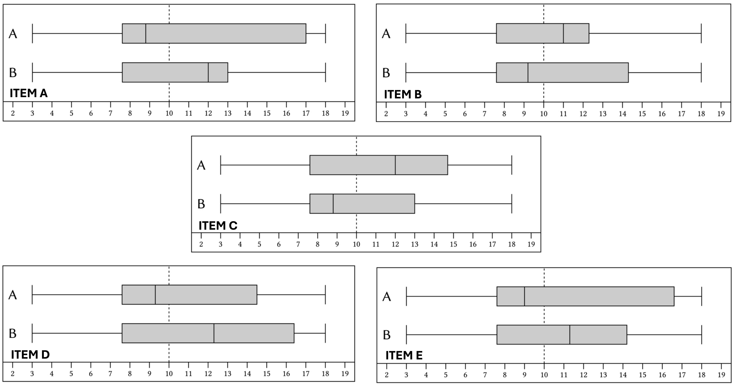
Discuss: Area bias
Which of the following items (task and question is the same) would a student with conceptual difficulty related to area bias answer incorrectly?
Notes:
Focus on how specific features of a boxplot task may invite area bias. Encourage participants to justify their interpretation using task features and, where relevant, expected student reasoning.
Possible guiding questions:
Which features of the boxplot task might invite a student to interpret box length or area as frequency?
What would a student with area bias likely attend to in this task?
What evidence would make you confident that this error is likely to occur?
How does this error relate to the student’s understanding of what the box and whiskers represent?

Slide 12
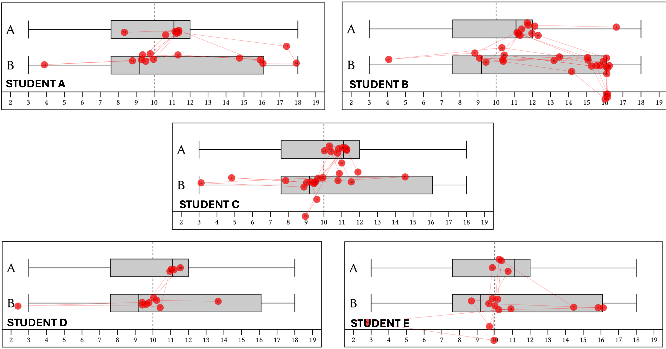

Discuss: Area bias
For the same items you see the gaze-pattern of five different students.
Which of these five different students – do you think – most likely provided an incorrect answer?
O Student A O Student B
O Student C O Student D
O Student E
Notes:
Possible guiding questions:
Which aspects of the gaze pattern support the hypothesis that the student may have area bias?
Could more than one gaze pattern be consistent with an incorrect interpretation? What additional evidence would help you decide?
How do the different gaze patterns show that students may approach the same boxplot task in different ways?
How could this kind of gaze evidence inform the questions you would ask a student afterwards?

Slide 13
Knowledge Recap: Boxplots
Go back to the original slide
Notes:
Slide- 64-65

Slide 14
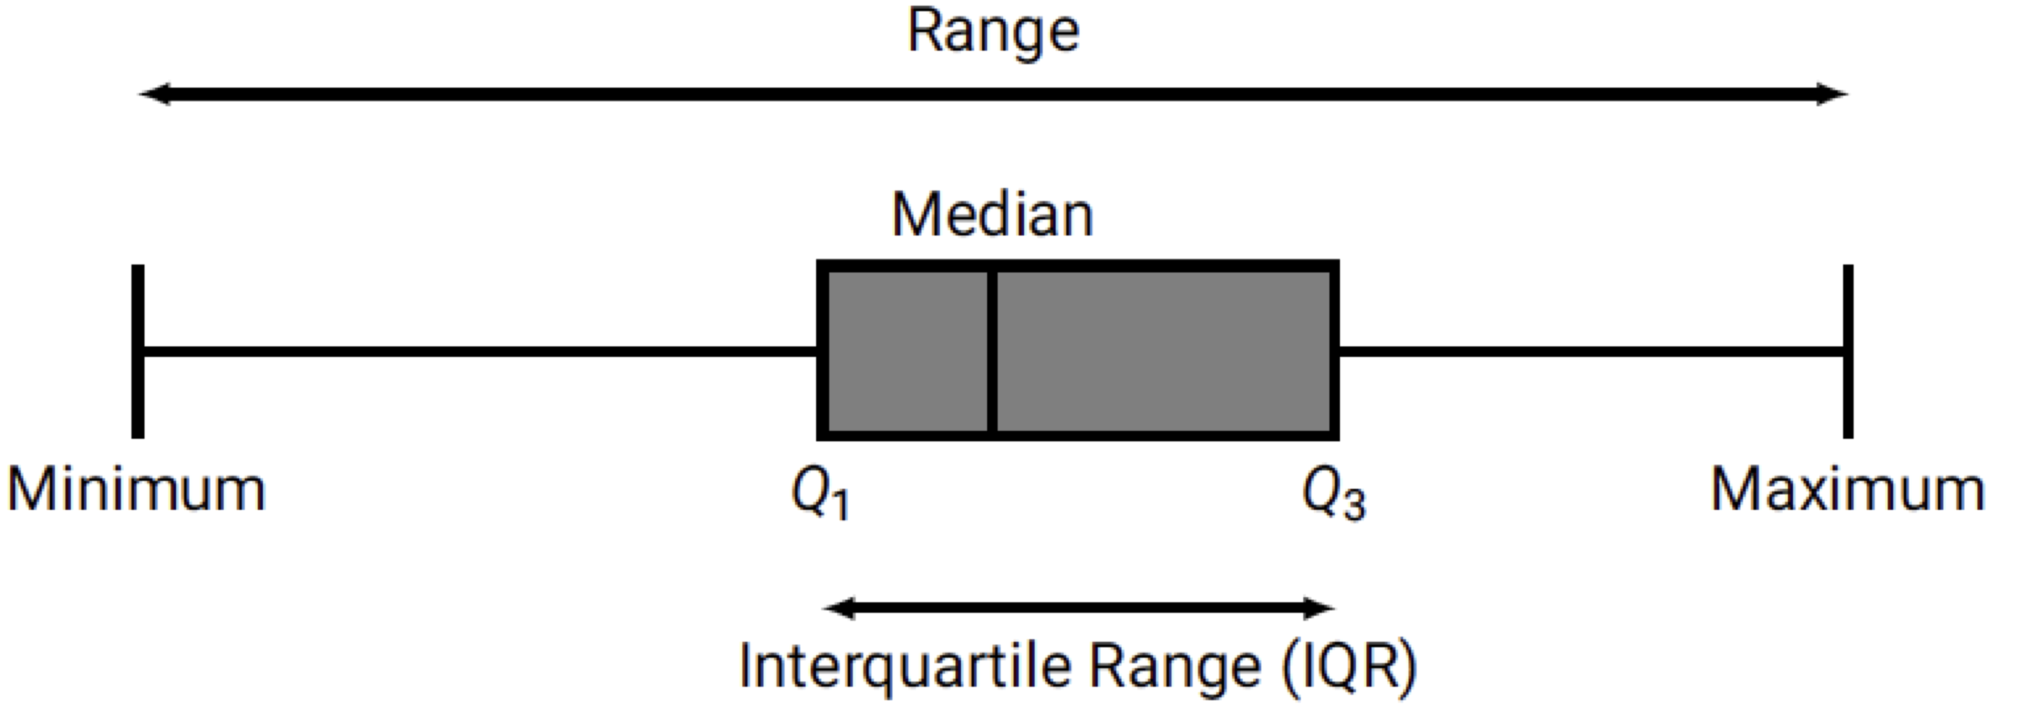
Content Knowledge Recap: Boxplots
A boxplot, also known as a box-and-whisker plot, is a graphical representation that provides a concise summary of the distribution of a dataset. It effectively displays key statistical measures in a visually intuitive manner. By showcasing these measures, boxplots offer valuable insights into the central tendency, variability, and skewness of the data. At its core, a boxplot consists of five main components: the median, the first quartile (Q1), the third quartile (Q3), the interquartile range (IQR), the extremes (maximum and minimum) and the range.
By combining these components, a boxplot offers a clear and concise summary of the distribution, and it is particularly useful for comparing the distributions of multiple datasets simultaneously, facilitating quick and effective data analysis and interpretation. In summary, a boxplot serves as a powerful tool in exploratory data analysis; whether used in statistical research, data visualization, or decision-making processes, boxplots are indispensable for understanding the distributional properties of data.
Go back to the original slide

Slide 15
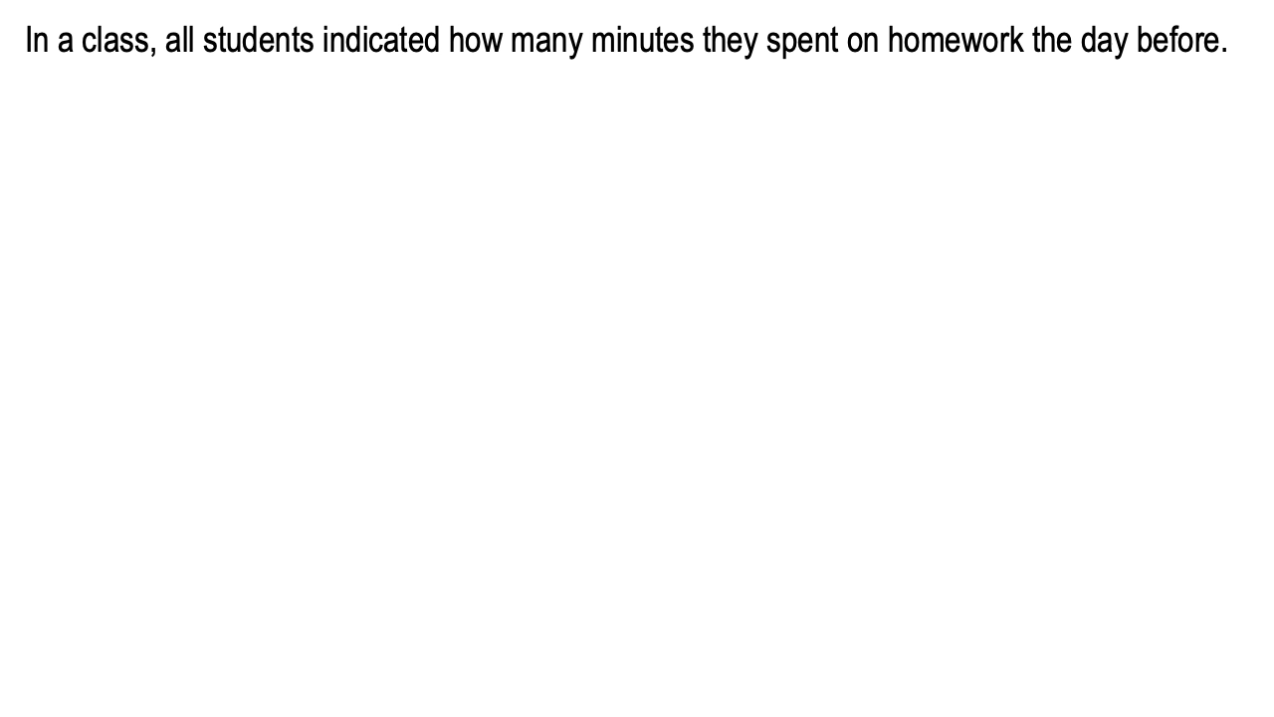
Content Knowledge Recap: Boxplots
Go back to the original slide

Slide 16
Eye-Teach-Stats in Context
Eye-Teach-Stats is an Erasmus+ project supporting pre- and in-service mathematics teachers in recognising and responding to students’ systematic errors in statistical graph interpretation.
The course builds on eye-tracking research conducted by the project partners with primary and secondary school students, focusing on students’ conceptions and difficulties when interpreting and comparing statistical graphs (Abt et al., 2023, 2024, 2025; Boels et al., 2019a, 2019b, 2023, 2025; Schreiter & Vogel, 2022, 2023a, 2023b, 2024).
The training consists of five modules: eye-tracking information, dotplots, histograms, case-value plots, and boxplots, and is disseminated in English, German, and Dutch.
Project partners:
Heidelberg University of Education (lead), HU University of Applied Sciences Utrecht, KU Leuven, University of Education Freiburg, and University of Education Schwäbisch Gmünd.
More information: www.eye-teach-stats.eu

Slide 17














Project Team
Markus Vogel, Ayline Heursen
Saskia Schreiter
Wim Van Dooren
Lonneke Boels, Vuslat Şeker, Anita Alexander

Slide 18



Disclaimer & License
The ‘Eye-teach-stats’ project (2023-1-DE03-KA220-SCH-000158223) is funded by the European Union. Views and opinions expressed are, however, those of the authors only and do not necessarily reflect those of the European Union or the National Agency. Neither the European Union nor the granting authority can be held responsible for them.
Teaching Modules © 2026 by Eye-Teach-Stats Project is licensed under CC BY-SA 4.0. To view a copy of this license, visit creativecommons.org/licenses/by-sa/4.0/

Slide 19
References
Abt, M., Reinhold, F., & Van Dooren, W. (2023). Revealing cognitive processes when comparing box plots using eye-tracking data—A pilot study. In M. Ayalon, B. Koichu, R. Leikin, L. Rubel, & M. Tabach (Eds.), Proceedings of the 46th Conference of the International Group for the Psychology of Mathematics Education (Vol. 2, pp. 11–18). PME.
Abt, M., Leuders, T., Loibl, K., Strohmaier, A. R., Van Dooren, W., & Reinhold, F. (2024). How can eye-tracking data be used to understand cognitive processes when comparing data sets with box plots? Frontiers in Education, 9, Article 1425663. https://doi.org/10.3389/feduc.2024.1425663
Abt, M., Loibl, K., Leuders, T., Van Dooren, W., & Reinhold, F. (2025). Understanding student errors in comparing data sets with boxplots. Educational Studies in Mathematics, 120, 169–193. https://doi.org/10.1007/s10649-025-10387-z
Boels, L., Bakker, A., & Drijvers, P. (2019a). Eye tracking secondary school students’ strategies when interpreting statistical graphs. In M. Graven, H. Venkat, A. A. Essien, & P. Vale (Eds.), Proceedings of the Forty-Third Conference of the International Group for the Psychology of Mathematics Education (Vol. 2, pp. 113–120). PME.
Boels, L., Bakker, A., & Drijvers, P. (2019b). Unravelling teachers’ strategies when interpreting histograms: An eye-tracking study. In U. T. Jankvist, M. Van den Heuvel-Panhuizen, & M. Veldhuis (Eds.), Proceedings of the Eleventh Congress of the European Society for Research in Mathematics Education (pp. 888–895). Freudenthal Group & Freudenthal Institute, Utrecht University, and ERME.
Boels, L., Lyford, A., Bakker, A., & Drijvers, P. (2023). Assessing students’ interpretations of histograms before and after interpreting dotplots: A gaze-based machine learning analysis. Frontline Learning Research, 11(2), 1–30. https://doi.org/10.14786/flr.v11i2.1139
Boels, L., Bakker, A., Van Dooren, W., & Drijvers, P. (2025). Secondary school students’ strategies when interpreting histograms and case-value plots: An eye-tracking study. Educational Studies in Mathematics, 118(3), 479–503. https://doi.org/10.1007/s10649-024-10351-3
Schreiter, S., & Vogel, M. (2022). Drawing inference from data when comparing groups: An eye-tracking study. In C. Fernández, S. Llinares, A. Gutiérrez, & N. Planas (Eds.), Proceedings of the 45th Conference of the International Group for the Psychology of Mathematics Education (Vol. 4, p. 285). PME.
Schreiter, S., & Vogel, M. (2023a). Eye-tracking measures as indicators for a local vs. global view of data. Frontiers in Education, 7, Article 1058150. https://doi.org/10.3389/feduc.2022.1058150
Schreiter, S., & Vogel, M. (2023b). Statistical thinking and viewing patterns when comparing data distributions: An eye-tracking study with 6th and 8th graders. In M. Ayalon, B. Koichu, R. Leikin, L. Rubel, & M. Tabach (Eds.), Proceedings of the 46th Conference of the International Group for the Psychology of Mathematics Education (Vol. 4, pp. 179–186). PME.
Schreiter, S., & Vogel, M. (2024). Students’ local vs. global views of data distributions: A cross-grade-level analysis using eye-tracking. Educational Studies in Mathematics. https://doi.org/10.1007/s10649-024-10352-2
For a list of publications in the project, please click: https://eye-teach-stats.eu/publications/

