Slide 1

EYE TEACH STATS
Teaching Modules
Notes:
These modules were designed by: Ayline Heursen, Vuslat Șeker, Martin Abt, Anita Alexander, Frank Reinhold, Lonneke Boels, Wim Van Dooren, Saskia Schreiter and Markus Vogel.

Slide 2
Opening question
How can we understand students’ thinking while interpreting statistical graphs?
Take a moment to reflect before continuing.

Slide 3
Reflection
When a student misinterprets a statistical graph, what evidence would you use to understand their thinking?
☐ Student’s answer
☐ Student’s explanation
☐ Written work
☐ Classroom observation
☐ Other
Notes:
Each source of evidence tells only part of the story. Students may arrive at the same answer for different reasons. Different students may also use different strategies to solve the same task.
Guiding question for teacher educators:
How can eye-tracking data complement other sources of evidence, such as students’ answers, explanations, and written work, when discussing students’ statistical (mis)interpretations?

Slide 4
Why does it matter?
Understanding students’ interpretations is essential for teaching statistics.
Students may arrive at the same answer for different reasons. Understanding how students interpret statistical graphs helps teachers analyse and respond to students’ (mis)interpretations.

Slide 5
Purpose
In this course you will learn to…
analyse students’ interpretations of statistical graphs.
recognise how students interpret different types of statistical graphs
recognise how these interpretations can lead to specific systematic errors.

Slide 6
Origin of the course:
From research with students to teacher learning
The Eye-Teach-Stats course is based on research with primary and secondary school students interpreting statistical graphs (Abt et al., 2025; Boels et al., 2025; Schreiter & Vogel, 2024).
In these studies, students’ answers, explanations, and eye-tracking data were analysed together to better understand how students read graphs and where systematic errors arise.
These insights were used to develop eye-tracking vignettes that help teachers analyse students’ reasoning, not only their answers.

Slide 7
The Course Journey
A Roadmap of the Five Modules
The course is organised into five main modules:
Module 1: Eye-tracking Information
Module 2: Dotplots
Module 3: Histograms
Module 4: Case-value plots
Module 5: Boxplots

Slide 8
The Course Journey
Eye-tracking Vignettes: Short scenes from real classrooms
Each module is built around vignettes: short, authentic scenes of a student working on a graph task, combined with eye-tracking data showing where the student looked.
Eye movements are presented in three ways: gazeplots, gaze videos, and heatmaps.
Notes:
Sources: Friesen et al., 2018; Rutsch et al., 2018
Friesen, M., Kuntze, S., & Vogel, M. (2018). Videos, Texte oder Comics? Die Rolle des Vignettenformats bei der Erhebung fachdidaktischer Analysekompetenz zum Umgang mit Darstellungen im Mathematikunterricht. In J. Rutsch, M. Rehm, M. Vogel, M. Seidenfuß, & T. Dörfler (Eds.), Effektive Kompetenzdiagnose in der Lehrerbildung (pp. 153–177). Springer.
Rutsch, J., Rehm, M., Vogel, M., Seidenfuß, M., & Dörfler, T. (Eds.). (2018). Effektive Kompetenzdiagnose in der Lehrerbildung: Professionalisierungsprozesse angehender Lehrkräfte untersuchen. Springer.

Slide 9
The Course Journey
Access the vignettes
1) Sign into MaMpf
https://mampf.mathi.uni-heidelberg.de/
2) Subscribe to the course
https://mampf.mathi.uni-heidelberg.de/lectures/358

Slide 10
Let’s Work Through a Vignette Together
Before working independently in MaMpf, let’s walk through one vignette together.
Example vignette:
20 Histogram
Notes:
PURPOSE
This is a collective walkthrough of one vignette, modeled by the teacher educator, before participants begin working independently in MaMpf. It introduces the vignette format and demonstrates the reasoning process expected throughout the course.
STEPS TO WORK THROUGH TOGETHER 1. Solve the statistical task yourselves. → As a group, look at the graph task and work out the answer. 2. Examine the student's response. → What did the student answer? What explanation did they give? 3. Analyse the student's gaze data. → Look at the gaze plot / heatmap / gaze video together. Where did the student look, in what order, for how long? 4. Formulate a hypothesis about the student's approach. → Based on the answer and the gaze data combined, what strategy might the student have used? 5. Compare this hypothesis with the student's explanation. → Does the student's own explanation support or challenge the hypothesis? 6. Identify possible systematic errors and underlying conceptual difficulties. → Which systematic error(s) does this reflect? What conceptual difficulty might be behind it?
FACILITATION TIPS - Think aloud as you go through each step, so the reasoning process is made explicit rather than assumed. - Ask participants to justify their interpretations using specific evidence (the answer, the explanation, or the gaze pattern) rather than general impressions. - Show explicitly how different sources of evidence (answer + explanation + gaze data) are combined to reach a conclusion. - The goal is not necessarily a single correct answer, but to model how to reason carefully and ground interpretations in evidence.
AFTER THIS SLIDE Participants continue independently in MaMpf, using the same reasoning process demonstrated here. (Source: Course Manual, Section 6.4 "Working Through a First Vignette Together")

Slide 11
MODULE 1:
EYE-TRACKING

Slide 12
What is eye-tracking?
Eye-tracking records where students look, in what order, and for how long while working on a task.
These gaze data can reveal visual search patterns that are normally hidden in the classroom.
Notes:
Sources: Spivey & Dale (2011)
Spivey, M. J., & Dale, R. (2011). Eye movements both reveal and influence problem solving. In S. P. Liversedge, I. D. Gilchrist, & S. Everling (Eds.), The Oxford handbook of eye movements (pp. 551–562). Oxford University Press.

Slide 13
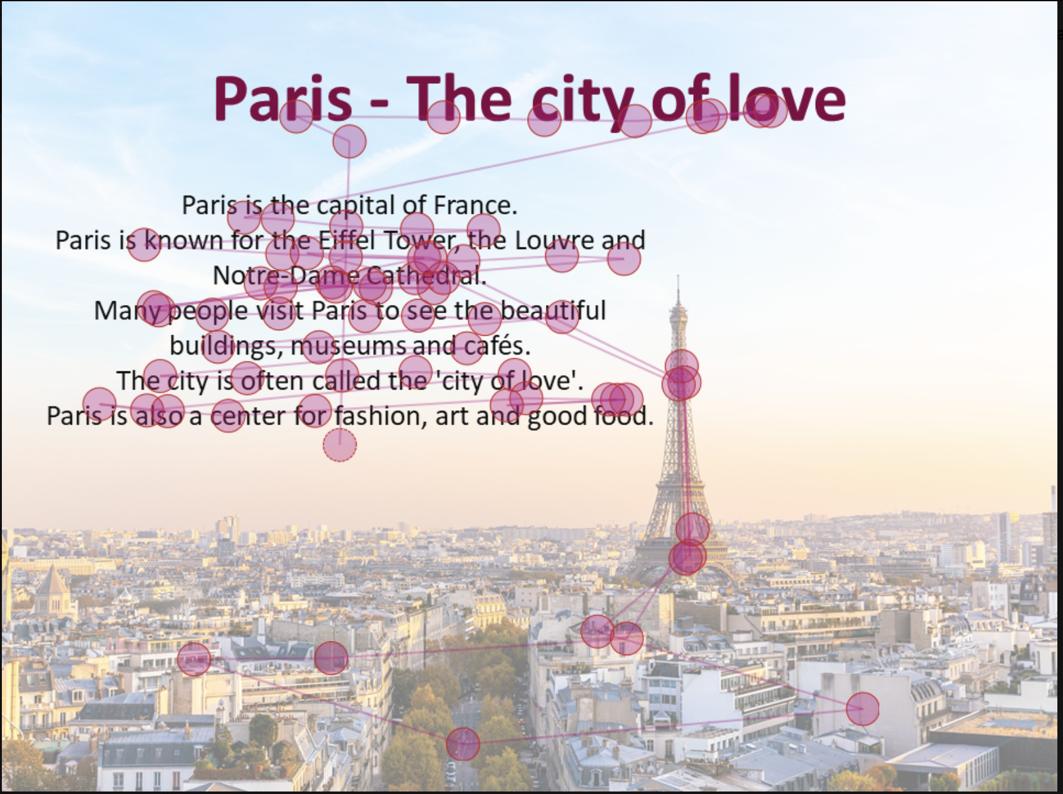
Gazeplot
In a gaze plot, gaze data collected from eye-tracking devices is superimposed onto the original stimulus, creating a combined view of both the stimulus and the participants’ eye movements.
Go back to the original slide
The visualisation includes dots and lines representing fixations and saccades, respectively. Fixations are depicted as dots, with each dot indicating a phase when the participant's gaze remains relatively stable on a specific area of the stimulus. The size of the dot typically corresponds to the duration of the fixation, with larger dots representing longer durations of fixation. Saccades, on the other hand, are represented by lines connecting two consecutive fixations. These lines indicate rapid eye movements between different areas of the stimulus.

Slide 14
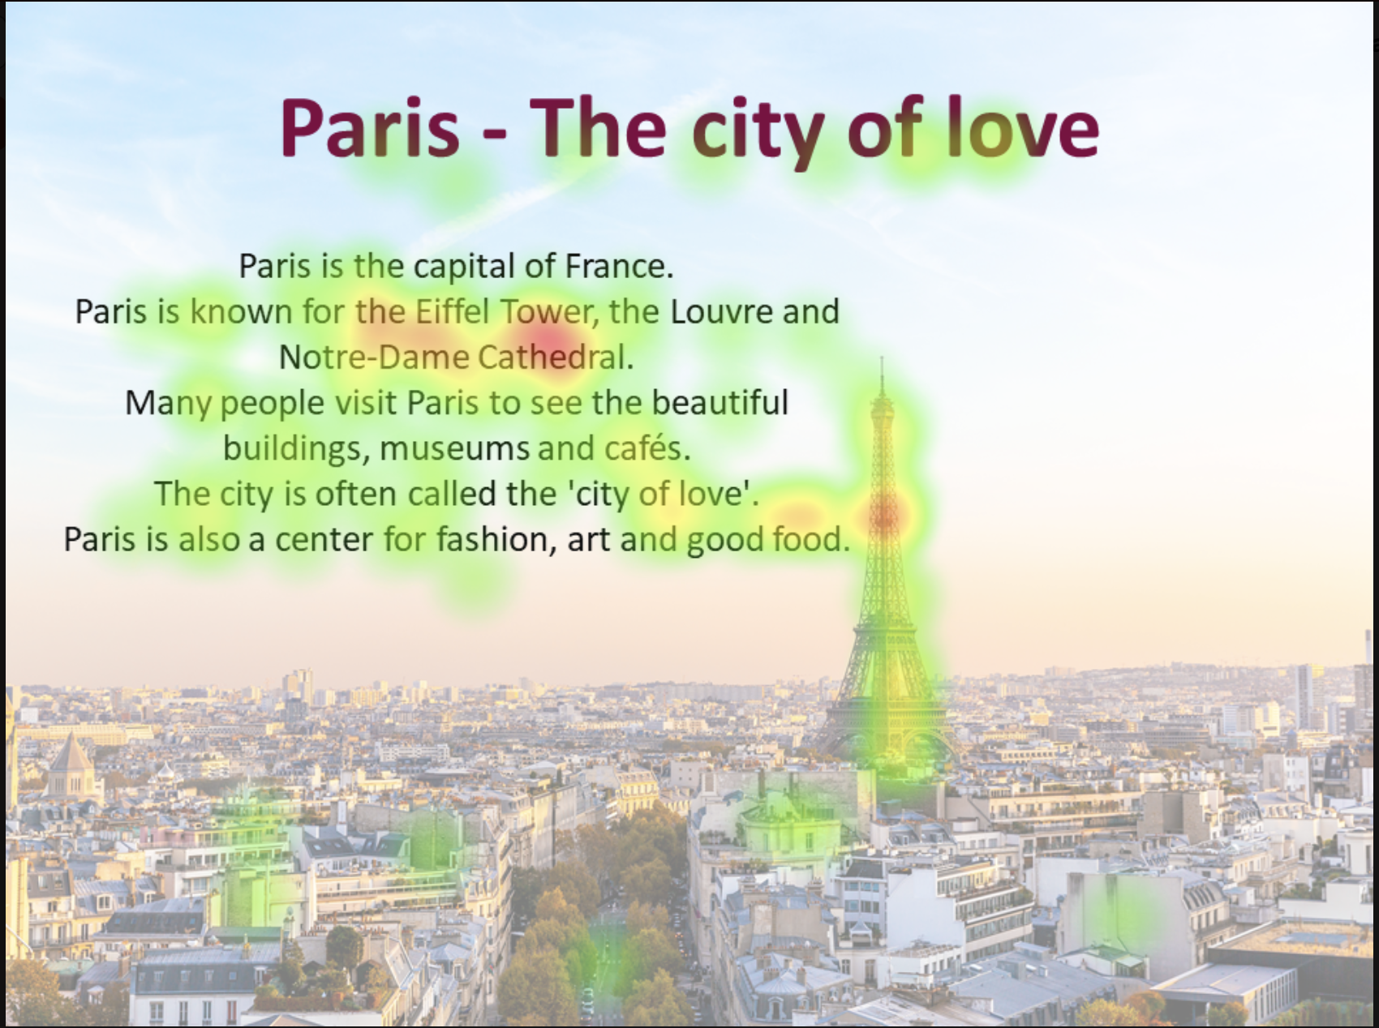
Heatmaps
In heat maps, gaze data captured by eye-tracking devices is superimposed on the original stimulus to create a combined view of both the stimulus and the participants’ gaze data.
Go back to the original slide
The visualisation shows coloured areas that represent fixations or saccades. The distribution of fixations, in which the participant remains relatively stable on an area of the stimulus, is indicated by the colouring from green to yellow to red. The redder and brighter the colours are, the longer this area is viewed.

Slide 15

Gaze video
In gaze video, gaze data collected from eye-tracking devices is superimposed onto the original stimulus, creating a combined view of both the stimulus and the participants’ eye movements.
Go back to the original slide
The visualisation includes dots representing fixations and lines representing saccades. Each dot indicating a moment when the participant’s gaze remains relatively stable on a specific area of the stimulus. The lines indicate rapid eye movements between two points.

Slide 16
MODULE 2:
DOTPLOTS

Slide 17
Introduction
Analysing Student Interpretations
In this module, you will analyse how students interpret dotplots, using eye-tracking vignettes to examine how specific solution strategies can lead to systematic errors.

Slide 18
Eye-Tracking Vignettes
Eye tracking vignettes
The following eye-tracking vignettes present students’ interpretations of dotplots.
Access and complete the vignette activities below. Focus on how the student interprets the graph and which systematic errors may be present.
https://mampf.mathi.uni-heidelberg.de/lectures/358
01 Dotplot
06 Dotplot
10 Dotplot
11 Dotplot

Slide 19
Content Knowledge Recap
Refreshing Content Knowledge
For a short recap, see Dotplots Recap
It outlines key features of dotplots, including the distinction between local and global perspectives.
Notes:
These recap slides correspond to the supportive information provided in the vignettes. They are included here for teacher educators to use when content knowledge needs to be refreshed or discussed.

Slide 20
What have you worked on in this module?
In this module, you explored how students (mis)interpret dotplots. You worked with examples related to:
Systematic error | Definition
Frequency–value confusion | Incorrect estimation of the mean of frequencies instead of the mean value.
Overemphasising outlier | Judgement based on an outlier rather than on the distribution.
Pairwise stack comparison | Judgement based on comparing corresponding stacks/bars one by one, rather than on the distribution as a whole.
Sum for Mean: Sum of measured values | Data values are added up—multiplied by their frequencies—to draw conclusions about the distribution.
Notes:
Guiding questions for teacher educators:
What did you learn about students’ interpretations of dotplots through the eye-tracking vignette(s)?
Which systematic error is evident, and what observable behaviour in the vignette supports your interpretation?
What might this indicate about underlying conceptual difficulties?

Slide 21
PCK Recap: Understanding student error
This module focuses on how students interpret dotplot and what their systematic errors may reveal about underlying conceptual difficulties.
Students may
  Focus on individual dots, specific stacks, or extreme values or outliers.
  Overlook that stacked dots represent frequency at a given value
  Draw conclusions from local features rather than from the overall shape, centre, or spread
  Focus too much on global features only, such as the shape, rather than the values of the measurement.
This is closely related to the local–global distinction: students may correctly read individual values but struggle to use them to reason about the distribution.
Notes:
Key questions for discussion:
Is the student reasoning about individual data points, or about the distribution as a whole?
What would need to change in the student's thinking for them to move from a local to a global view?

Slide 22
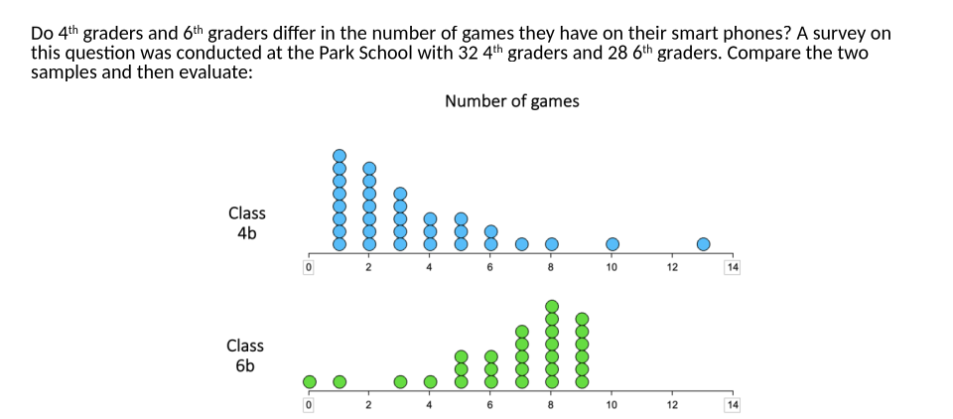
Discuss: Pairwise stack comparison
Look at the dotplots above. Consider a student who compares corresponding stacks one by one rather than reading the distributions as wholes. What conclusion might this student reach? Describe the gaze pattern you would expect, and consider whether this error is likely to occur with this particular graph.
Notes:
Teacher educator note:
Use this slide to open the discussion phase and to help participants move from identifying an incorrect answer to interpreting what the student may have attended to and how this may relate to an underlying conceptual difficulty.
Possible guiding questions:
What does this systematic error reveal about how the student may be interpreting the dotplot?
Which features of the graph does the student seem to use as evidence for their conclusion?
What might the student be overlooking when comparing the two distributions?
How could you support the student in moving from comparing individual stacks to comparing the distributions as wholes?

Slide 23
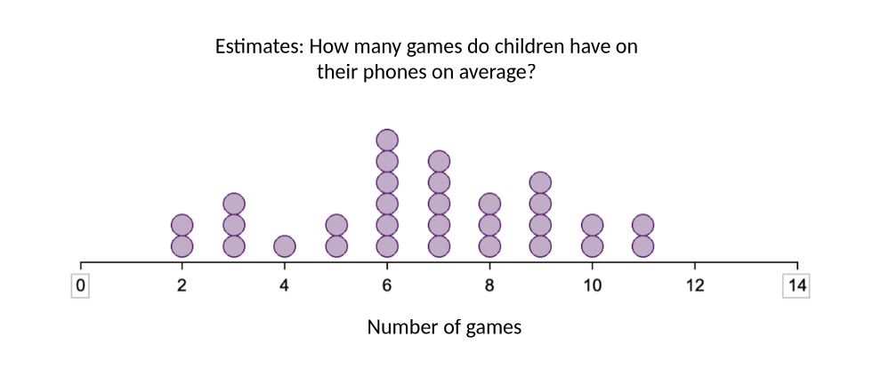
Discuss: Frequency-value confusion
Look at the task above. A student with frequency–value confusion would use the frequencies of the data points rather than the data values themselves to estimate the mean. Based on this, what answer would this student likely give? Describe the gaze pattern you would expect to see.
Notes:
Teacher educator note:
Focus the discussion on how gaze data can support or refine a hypothesis about frequency–value confusion. Encourage participants to connect the student’s answer, gaze pattern, and possible interpretation of the graph.
Possible guiding questions:
Which features of the dotplot might a student attend to when confusing frequency with data value?
What gaze pattern would support the hypothesis that the student is treating stack height as a value?
What question could you ask the student to find out how they understand the dots, stacks, and horizontal axis?

Slide 24
MODULE 3:
HISTOGRAM

Slide 25
Introduction
Analysing Student Interpretations
In this module, you will analyse how students interpret histograms, using eye-tracking vignettes to examine how specific solution strategies can lead to systematic errors.

Slide 26
Histogram: Eye-Tracking Vignettes
Eye tracking vignettes
The following eye-tracking vignettes present students’ interpretations of histograms.
Access and complete the vignette activities below. Focus on how the student interprets the graph and which systematic errors may be present.
https://mampf.mathi.uni-heidelberg.de/lectures/358
07 Histogram
09 Histogram
12 Histogram
13 Histogram
17 Histogram
19 Histogram

Slide 27
Content Knowledge Recap
Refreshing Content Knowledge
For a short recap, see the Histograms Recap
It outlines the key features of histograms.
Notes:
These recap slides correspond to the supportive information provided in the vignettes. They are included here for teacher educators to use when content knowledge needs to be refreshed or discussed.

Slide 28
What have you worked on in this module?
In this module, you explored how students (mis)interpret histograms. You worked with examples related to:
Systematic error | Definition
Frequency–value confusion | Incorrect estimation of the mean of frequencies instead of the mean value.
Sum for mean: Sum of frequencies | Frequencies are added up to draw conclusions about statistical concepts or the overall data distribution.
Pairwise stack comparison | Judgement based on comparing corresponding stacks/bars one by one, rather than on the distribution as a whole.
Overemphasising number of bars | Judgement based on the number of bars rather than on the distribution.

Slide 29
PCK Recap: Understanding Student Error
This module focuses on how students interpret histogram and what their systematic errors may reveal about underlying conceptual difficulties.
Students may:
  Treat bar heights as measured values rather than frequencies
  Add up frequencies instead of reasoning about the mean as a balance point
  Fail to integrate local and global features (e.g., bar positions vs. overall shape), overemphasising one at the expense of the other
  Overlook that the mean is located on the horizontal axis, not the vertical axis.
A key conceptual difficulty: students may not yet understand that the mean in a histogram is a property of the distribution, not a value that can be read directly from a single bar.
Notes:
Key questions for discussion:
What does the student think the bar height represents — a frequency or a data value?
How does the student's error relate to their understanding of the mean as a balance point of the distribution?

Slide 30
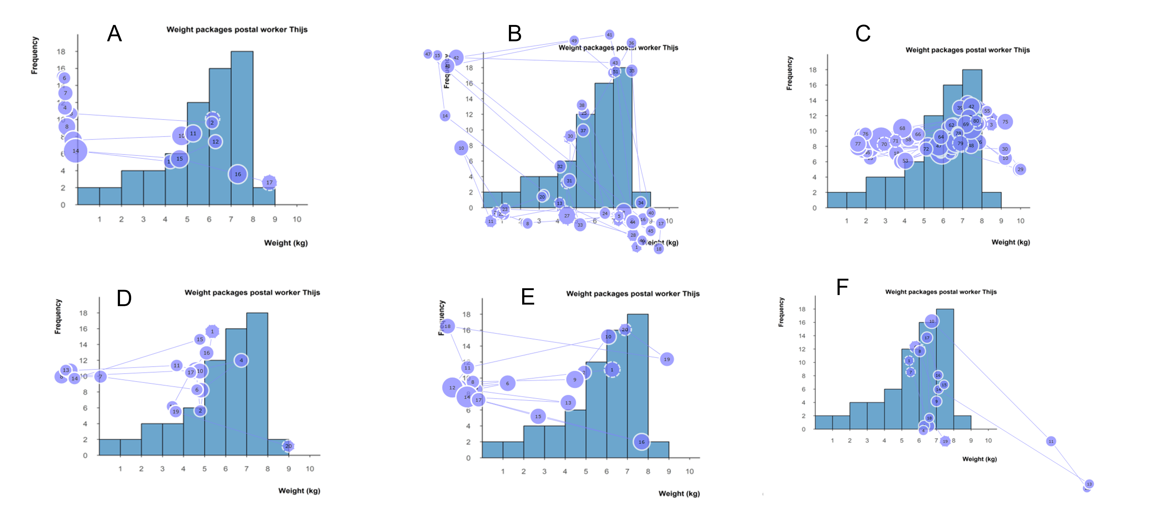
Discuss: Frequency-value confusion
Given the gaze plots of six students for the same item, identify which students are likely to make a frequency-value confusion systematic error. Please provide detailed reasons why you have a) opted for a student
[xy], and b) decided against the other students.
Notes:
Teacher educator note:
This task asks participants to identify possible frequency–value confusion from several gaze plots. Focus the discussion on the evidence used for classification and on the limits of what can be inferred from gaze data alone.
Possible guiding questions:
Which gaze patterns provide evidence for frequency–value confusion in this histogram task?
Which students were more difficult to classify, and what made the gaze evidence less clear?
How could the student’s answer or explanation strengthen or change your interpretation of the gaze data?
What might it suggest for instruction if several students show similar gaze patterns on the same task?

Slide 31
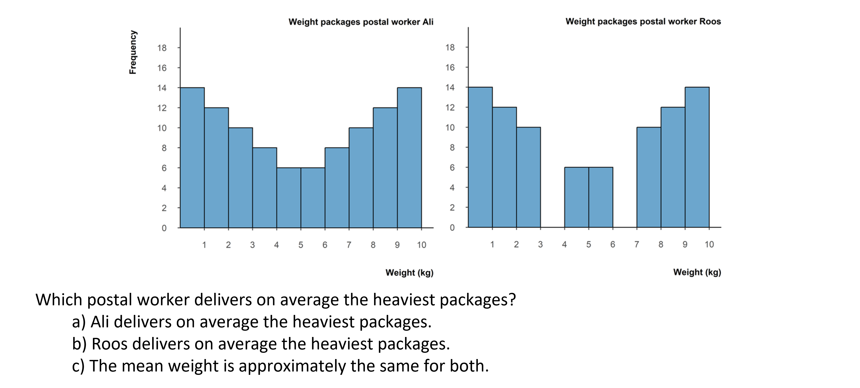
Discuss: Overemphasising the number of bars
Look at the histogram above. Consider a student who bases their judgement on the number of bars rather than on the distribution. What conclusion might this student reach? Describe the gaze pattern you would expect, and consider whether this error is likely to occur with this particular graph.
Notes:
Teacher educator note:
Focus on how students may rely on a visible and countable feature of the histogram—the number of bars—rather than reasoning about the measured values, frequencies, and the distribution as a whole.
Possible guiding questions:
Why might the number of visible bars be a salient feature for students in this task?
What might a student overlook if they base their judgement mainly on the number of bars?
What gaze pattern would support the hypothesis that the student is focusing on the number of bars?
What follow-up question could help the student attend to the position of the bars and the overall distribution?

Slide 32
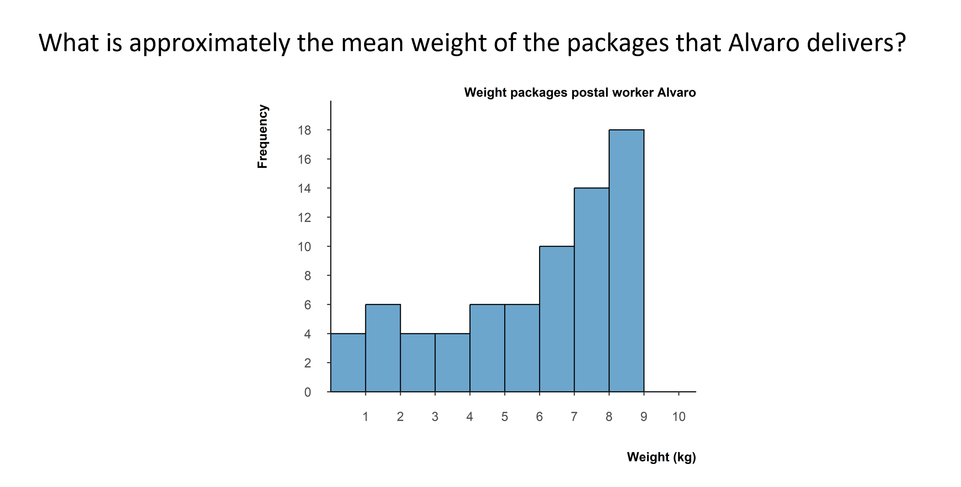
Discuss: Sum for mean: Sum of frequencies
Look at the histogram below. Consider a student who adds up the frequencies and dividing number of bars rather than estimating the mean of the data values. What answer might this student give? Describe the gaze pattern you would expect, and consider whether this error is likely to occur with this particular graph.
Notes:
Teacher educator note:
Use this slide to distinguish the sum of frequencies error from other histogram errors. Focus on what the student may be treating as data and how the gaze pattern can provide evidence for this interpretation.
Possible guiding questions:
What does the sum of frequencies error suggest about what the student treats as the data in a histogram?
How is this error related to, but different from, frequency–value confusion?
What gaze pattern would you expect from a student who adds frequencies and divides by the number of bars?
What follow-up task or question could help you distinguish between frequency–value confusion and sum of frequencies?

Slide 33
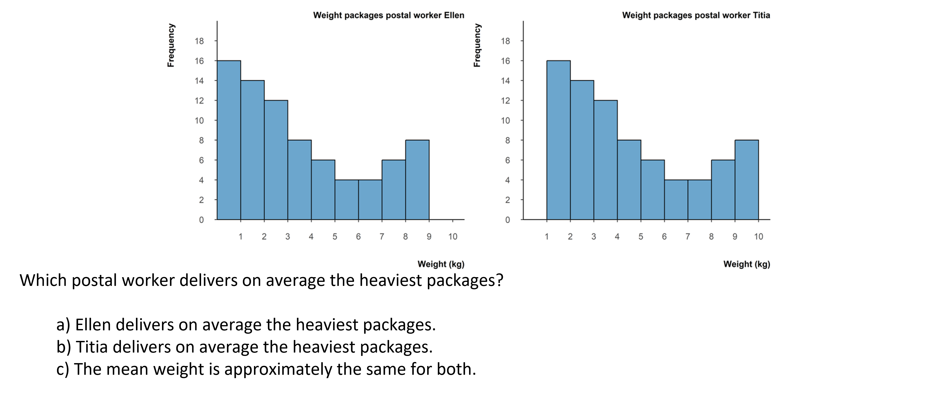
Discuss: Pairwise stack comparison
Look at the histograms above. Consider a student who compares individual bars one by one rather than reading the distribution as a whole. What conclusion might this student reach? Describe the gaze pattern you would expect, and consider whether this error is likely to occur with this particular graph.
Notes:
Teacher educator note:
Focus on the student’s local, bar-by-bar comparison of two histograms. Use the discussion to contrast comparing individual bars with interpreting the overall distribution, including centre, shift, spread, and shape.
Possible guiding questions:
What might pairwise stack comparison reveal about how the student compares the two histograms?
Which global features of the distributions might the student be overlooking?
What gaze pattern would support the hypothesis that the student is comparing bars pairwise?
How could you prompt the student to compare the distributions as wholes rather than focusing only on corresponding bars?

Slide 34
MODULE 4:
CASE-VALUE PLOTS

Slide 35
Introduction
Analysing Student Interpretations
In this module, you will analyse how students interpret case-value plots, using eye-tracking vignettes to examine how specific solution strategies can lead to systematic errors.

Slide 36
Eye-Tracking Vignettes
Vignette Activities
The following eye-tracking vignettes present students’ interpretations of case-value plots.
Access and complete the vignette activities below.
Focus on how the student interprets the graph and which systematic errors may be present.
https://mampf.mathi.uni-heidelberg.de/lectures/358
04 Case-value plots
05 Case-value plots
08 Case-value plots
18 Case-value plots

Slide 37
Content Knowledge Recap
Refreshing Content Knowledge
For a short recap, see Case-value plots Recap.
It outlines key features of case-value plots, including how to distinguish case-value plots from histograms.
Notes:
These recap slides correspond to the supportive information provided in the vignettes. They are included here for teacher educators to use when content knowledge needs to be refreshed or discussed.

Slide 38
What have you worked on in this module?
In this module, you explored how students (mis)interpret case-value plots. You worked with examples related to:
Systematic error | Definition
Overgeneralisation of a histogram approach | Incorrect assumption that a case-value plot can be interpreted like a histogram, based on shape or balance rather than on individual measured values.
Pairwise stack comparison | Judgement based on comparing corresponding stacks/bars one by one, rather than on the distribution as a whole.

Slide 39
PCK Recap: Understanding student error
This module focuses on how students interpret case-value plots and what their systematic errors may reveal about underlying conceptual difficulties.
Students may:
  Apply a histogram-reading strategy, interpreting bar heights as frequencies
  Compare visible bars pairwise without considering the full set of values
  Overlook zero bars, which represent cases with a measured value of zero
  Focus on visual patterns or symmetry instead of reasoning about individual measured values
  A key conceptual difficulty: students may not yet understand that each bar in a case-value plot represents one individual measured value — and that all values, including zeros, contribute to the mean.
Notes:
Key questions for discussion:
What does the student think each bar represents — a frequency or a measured value?
How does the student's approach change when zero values are present in the graph?

Slide 40
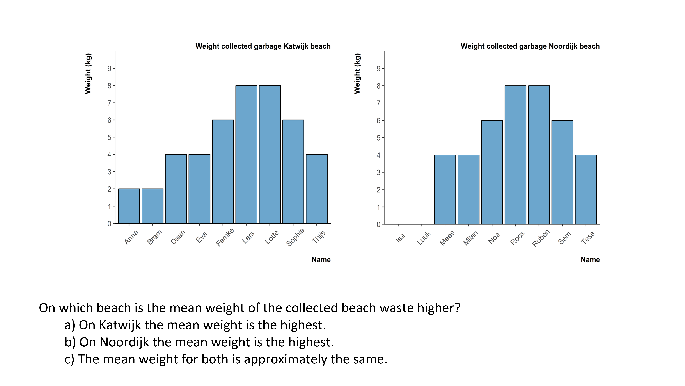
Discuss: Pairwise stack comparison
Look at the case-value plot above. Consider a student who bases their comparison mainly on the visible bars.
What conclusion might this student reach? Describe the gaze pattern you would expect, and consider which measured values the student might take into account or overlook.
Notes:
Teacher educator note:
Use this slide to discuss how students may compare visible bars in case-value plots without taking all measured values into account. In particular, focus on whether zero values are noticed and included in reasoning about the mean.
Possible guiding questions:
Which bars or values does the student seem to take into account when comparing the two case-value plots?
Does the student appear to include zero values as measured values? What evidence supports your interpretation?
What gaze pattern would you expect from a student who mainly compares visible non-zero bars?
How could you help the student recognise that each case, including a zero value, contributes to the mean?

Slide 41
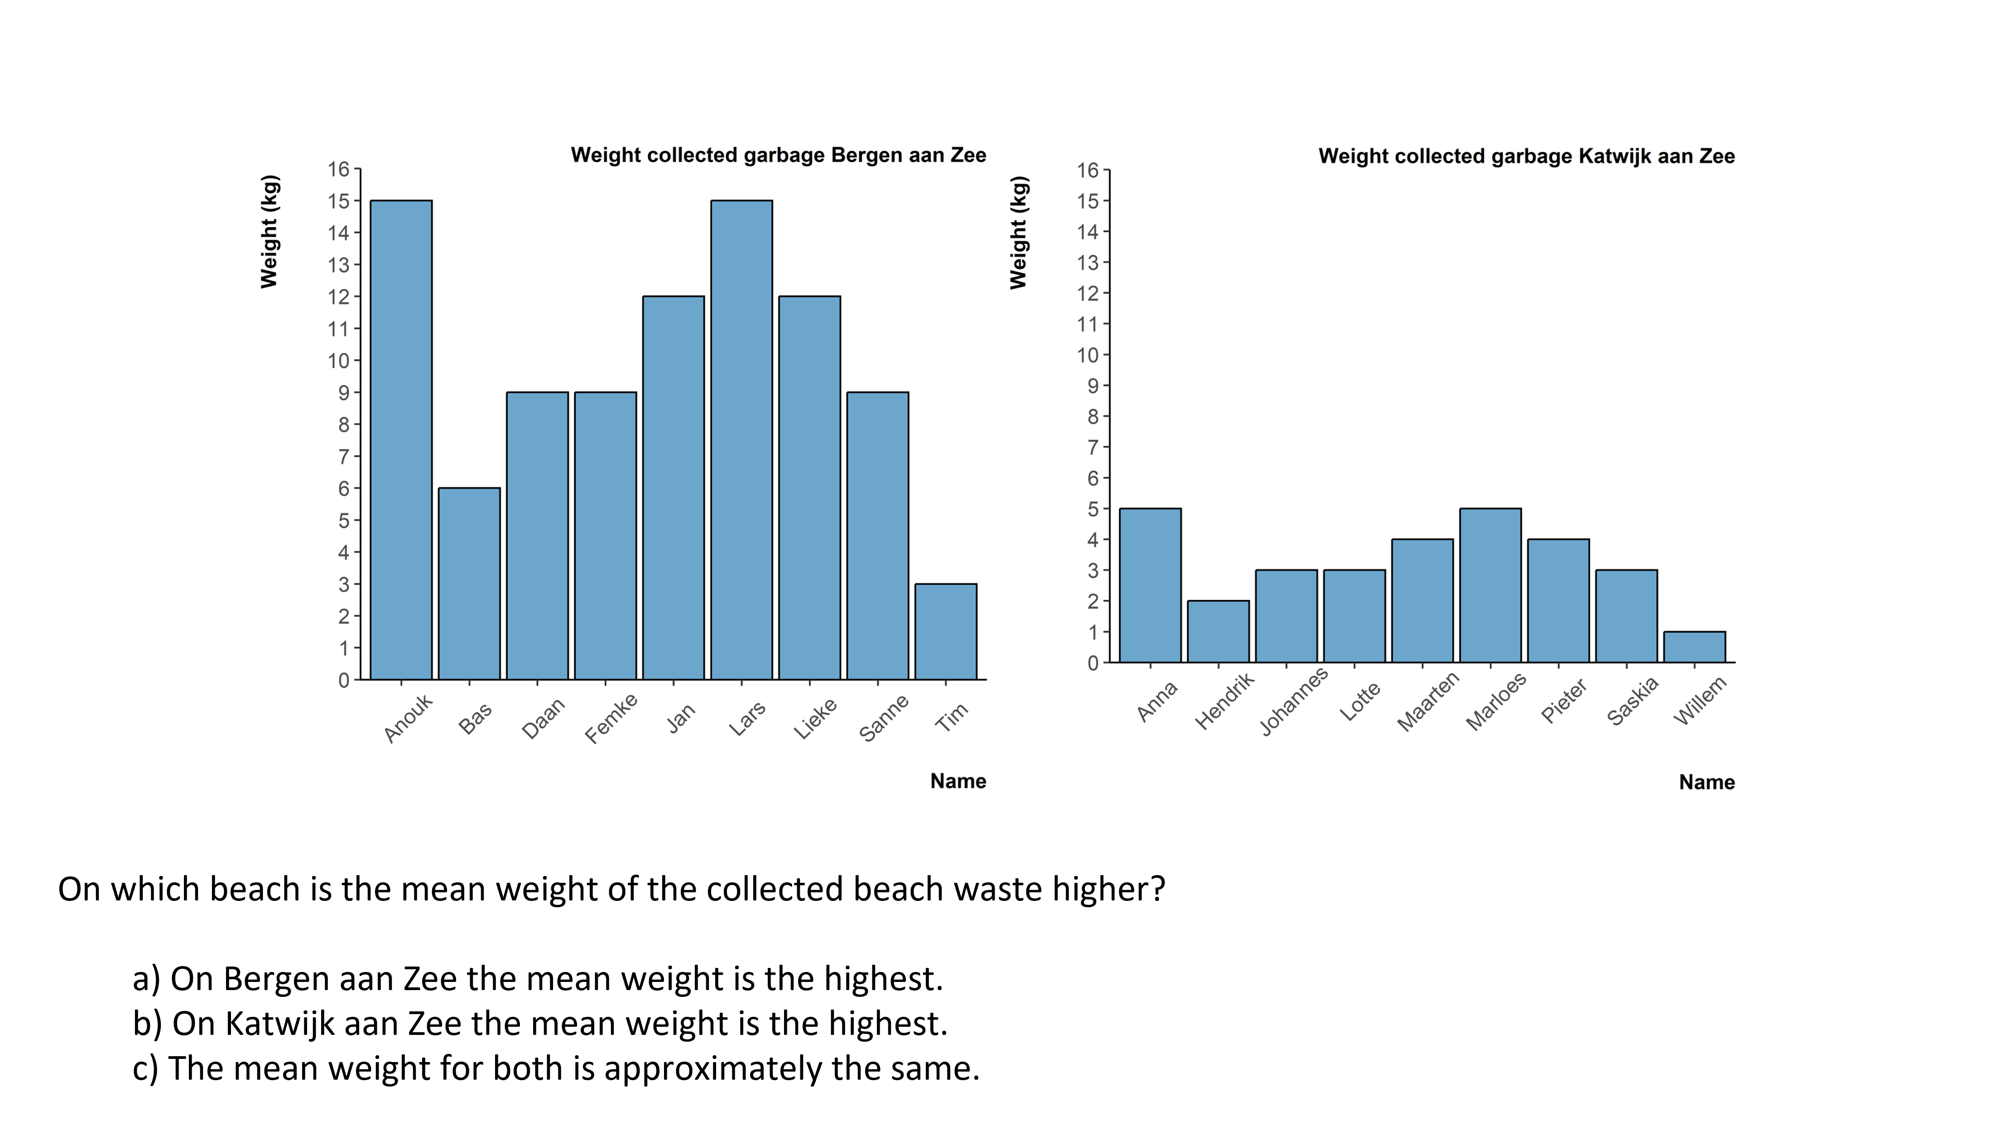
Discuss: Overgeneralisation of a histogram approach
Look at the case-value plot below. Consider a student who shows overgeneralisation of a histogram approach when interpreting this graph, for example by focusing on the visual pattern of the bars rather than on the individual measured values.
What conclusion might this student reach? Describe the gaze pattern you would expect, and consider whether this systematic error is likely to occur with this particular graph.
Notes:
Teacher educator note:
This discussion focuses on the inappropriate transfer of a histogram approach to case-value plots. Encourage participants to identify what the student may be assuming about bar height, visual pattern, and mean.
Possible guiding questions:
What might this error reveal about how the student interprets bar-like graphs?
Which aspects of the case-value plot might invite a histogram-like interpretation?
What gaze pattern would support the hypothesis that the student is focusing on visual pattern, symmetry, or balance?
How could you make the difference between histograms and case-value plots explicit in a classroom conversation?

Slide 42
MODULE 5:
BOXPLOTS

Slide 43
Introduction
Analysing Student Interpretations
In this module, you will analyse how students interpret boxplots, using eye-tracking vignettes to examine how specific solution strategies can lead to systematic errors.

Slide 44
Boxplot: Eye-Tracking Vignettes
Vignette Activities
The following eye-tracking vignettes present students’ interpretations of boxplots.
Access and complete the vignette activities below. Focus on how the student interprets the graph and which systematic errors may be present.
https://mampf.mathi.uni-heidelberg.de/lectures/358
02 Boxplot
03 Boxplot
14 Boxplot
15 Boxplot
16 Boxplot

Slide 45
Content Knowledge Recap
Refreshing Content Knowledge
For a short recap, see Boxplot Recap.
It outlines key features of boxplots, including acquiring conceptual knowledge on variability.
Notes:
These recap slides correspond to the supportive information provided in the vignettes. They are included here for teacher educators to use when content knowledge needs to be refreshed or discussed.

Slide 46
What have you worked on in this module?
In this module, you explored how students (mis)interpret boxplots. You worked with examples related to:
Systematic error | Definition
Median bias | Judgement based on an incorrect measure of central tendency.
Area bias | Incorrect assumption that a longer box represents a higher frequency of observations.

Slide 47
PCK Recap: Understanding student error
This module focuses on how students interpret boxplotand what their systematic errors may reveal about underlying conceptual difficulties.
Students may:
  Overgeneralise the median as the only relevant measure for every question
  Interpret a longer or larger box as representing more observations
            Focus on area or length rather than on the boundaries the box represents
              Overlook that quartiles divide the data into equal proportions, not equal intervals
A key conceptual difficulty: students may interpret visual size as representing frequency, rather than understanding that each section of the boxplot represents the same proportion of the data.
Notes:
Key questions for discussion:
Which element of the boxplot does the student rely on, and does it match what that element actually represents?
Does the student understand that each section of the boxplot represents the same proportion of the data, regardless of its visual size?

Slide 48
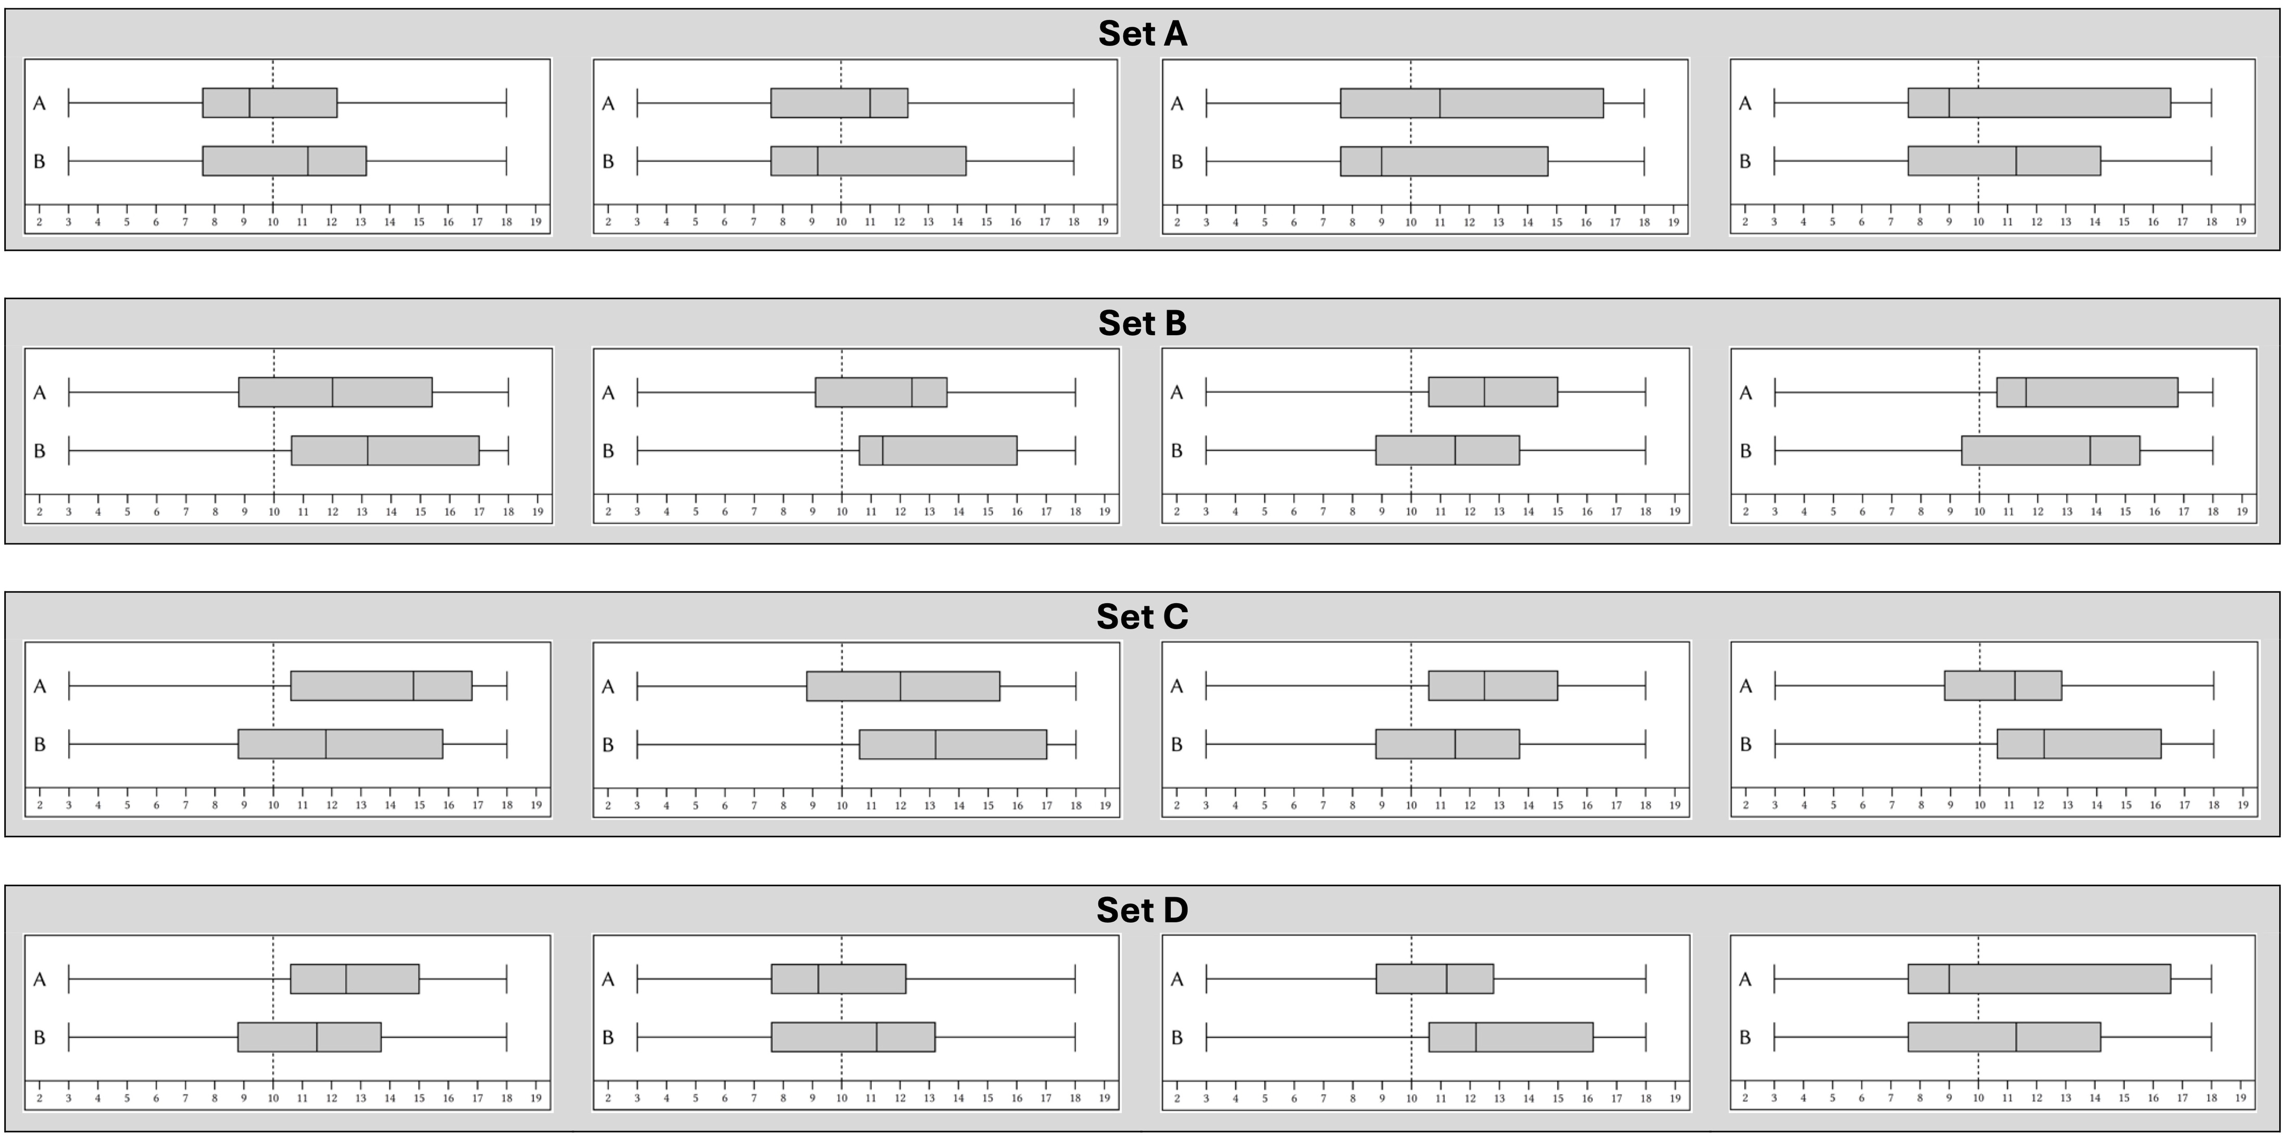
Discuss: Median bias
Suppose you suspect that one of your students makes systematic error median bias. Which of the following item sets would you let your student solve so that you are sure? Please provide detailed reasons why you have
opted for item set
decided against the other item sets.
Notes:
Teacher educator note:
This task shifts the discussion from identifying an error to selecting items that can reveal a conceptual difficulty. Use it to discuss what makes a task informative for diagnosing median bias.
Possible guiding questions:
What should an item set make visible if you want to investigate median bias?
What answer would you expect from a student who relies mainly on the median, and why?
Why is one item set more informative than the others for this specific conceptual difficulty?
How does choosing a follow-up item help you learn more about the student’s understanding of boxplots?

Slide 49
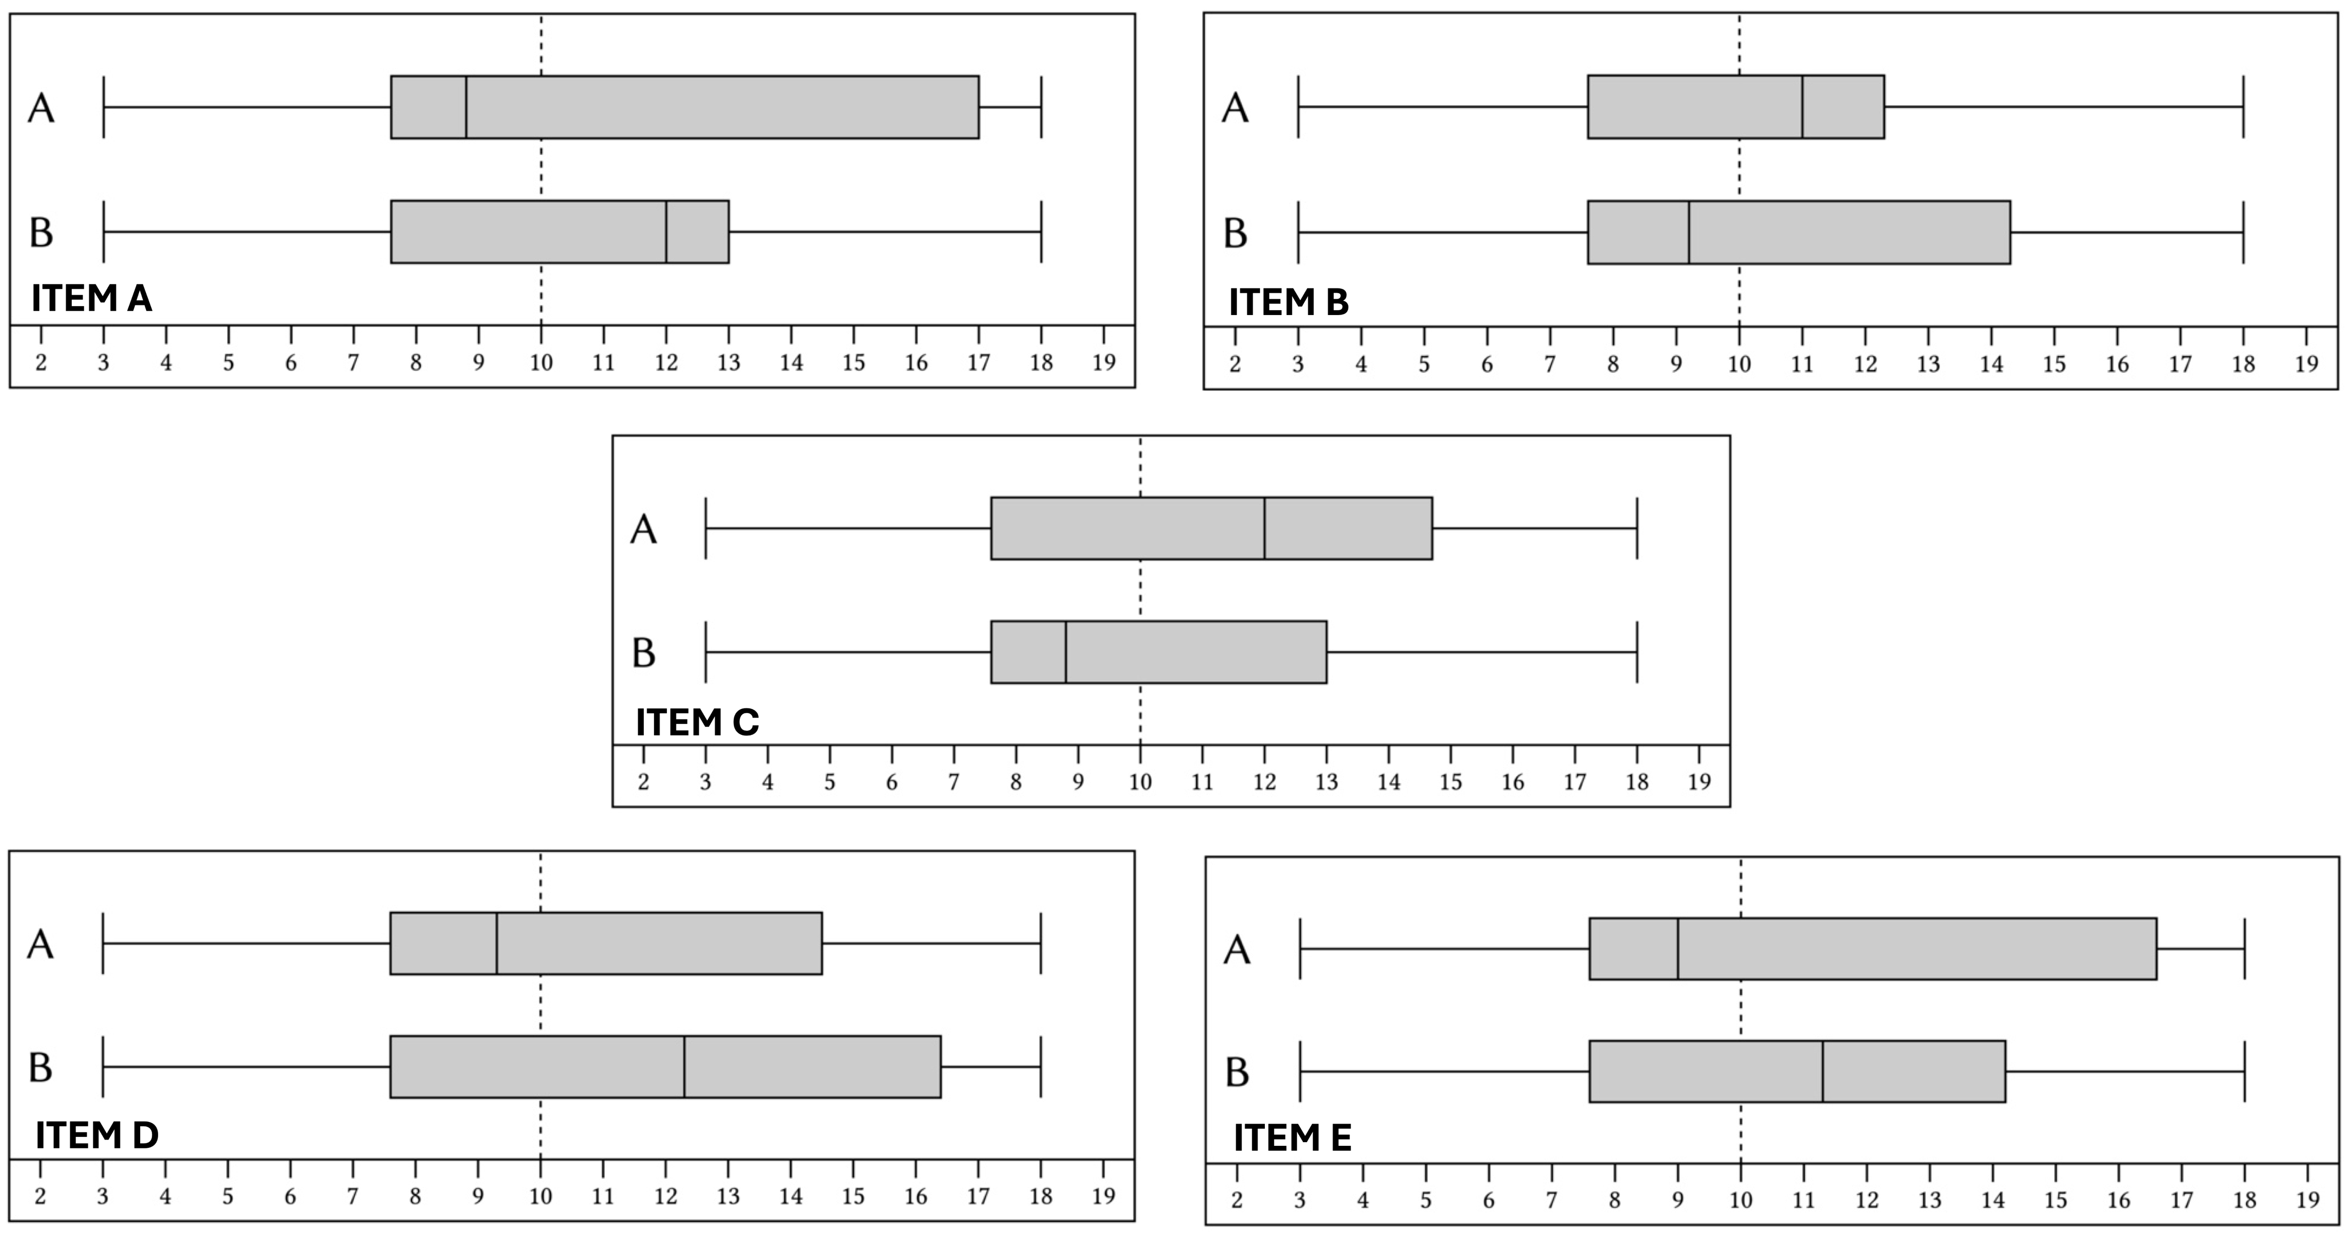
Discuss: Area bias
Which of the following items (task and question is the same) would a student with conceptual difficulty related to area bias answer incorrectly?
Notes:
Focus on how specific features of a boxplot task may invite area bias. Encourage participants to justify their interpretation using task features and, where relevant, expected student reasoning.
Possible guiding questions:
Which features of the boxplot task might invite a student to interpret box length or area as frequency?
What would a student with area bias likely attend to in this task?
What evidence would make you confident that this error is likely to occur?
How does this error relate to the student’s understanding of what the box and whiskers represent?

Slide 50
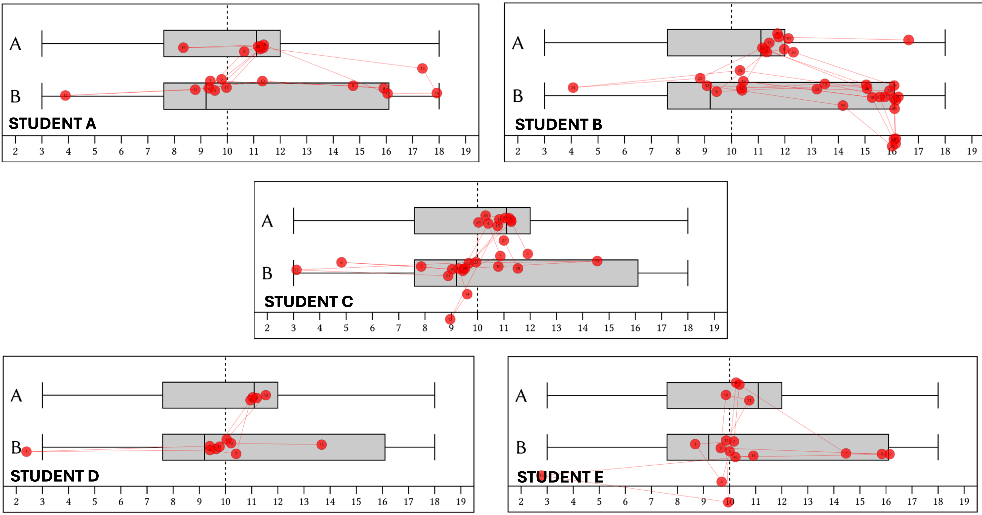

Discuss: Area bias
For the same items you see the gaze-pattern of five different students.
Which of these five different students – do you think – most likely provided an incorrect answer?
O Student A O Student B
O Student C O Student D
O Student E
Notes:
Possible guiding questions:
Which aspects of the gaze pattern support the hypothesis that the student may have area bias?
Could more than one gaze pattern be consistent with an incorrect interpretation? What additional evidence would help you decide?
How do the different gaze patterns show that students may approach the same boxplot task in different ways?
How could this kind of gaze evidence inform the questions you would ask a student afterwards?

Slide 51
Closing
This brings you to the end of the five modules.
Thank you for working through the vignettes and engaging with students’ interpretations of statistical graphs.

Slide 52
KNOWLEDGE RECAP

Slide 53
Knowledge Recap: Dotplots
Go back to the original slide
Notes:
Slide 54-55-56 - Dotplot

Slide 54
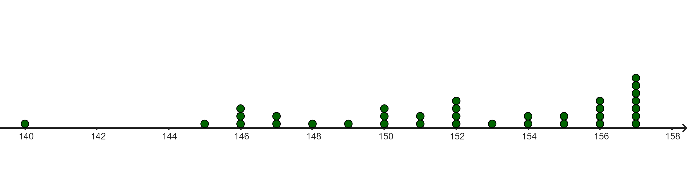
Content Knowledge Recap: Dotplots
Dotplots are graphical representations used to display the distribution of a dataset. In a dotplot, each data point is represented by a dot along a single axis, typically the horizontal axis. If multiple data points have the same value, their dots are stacked vertically. They are particularly useful for small to medium-sized datasets.
The height of children in class 5
stack
Go back to the original slide
data point
measured variable: height in cm
To compare distributions presented in dotplots, global features as well as local details can be taken into account.

Slide 55
Content Knowledge Recap: Dotplots
Perspectives on data distributions: Local vs. global views:
A central aim in statistics education is to guide students to develop also a “global view” of data distributions. In this perspective, students perceive distributions as conceptual entities with holistic features such as centre, spread, and shape. However, students frequently perceive distributions as mere collections of individual data points, leading them to focus excessively on local details of the distribution. This is called a “local view” of data distributions.
Global view | distribution (conceptual entity) |  |  | Local view
 | global features
 | center visually estimated mean … | spread/density observed spread-out-ness, majority, range… | shape observed skewness, peaks, tails…
 | local features individual data points extreme values, outlier, absolute frequency of dots in certain intervals, value of certain intervals of dots, disjoint edge values…
Go back to the original slide
Adapted according to Schreiter & Vogel, 2023

Slide 56
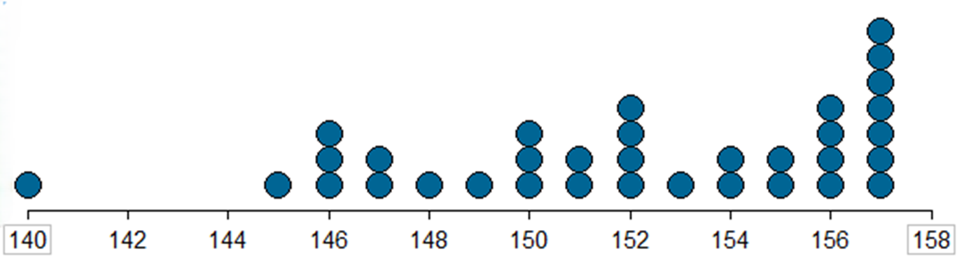
Content Knowledge Recap: Dotplots
To compare distributions presented in dotplots, global features (e.g., centre, spread/density, shape) as well as local features (e.g., outlier) can be taken into account.
The height (in cm) of children in class 5
center: mean
Go back to the original slide
Individual data point: outlier
shape
frequency of dots in certain interval
Spread / density: range

Slide 57
Knowledge Recap: Histogram
Go back to the original slide
Notes:
Slide 58-59 Histogram

Slide 58
Content Knowledge Recap: Histogram
A histogram is a graph with bars that meets the following criteria:
• It consists of bars that represent grouped numerical data.
• It represents data of one statistical variable only (typically continuous).
• The statistical variable is presented conventionally on the horizontal axis.
• The statistical variable is measured at an interval or ratio measurement level.
• The vertical axis displays the class density, or—when bin widths are equal—relative or absolute frequency (counts) of the depicted statistical variable.
• The total density adds up to 1 or the total relative frequency adds up to 100%.
Go back to the original slide

Slide 59
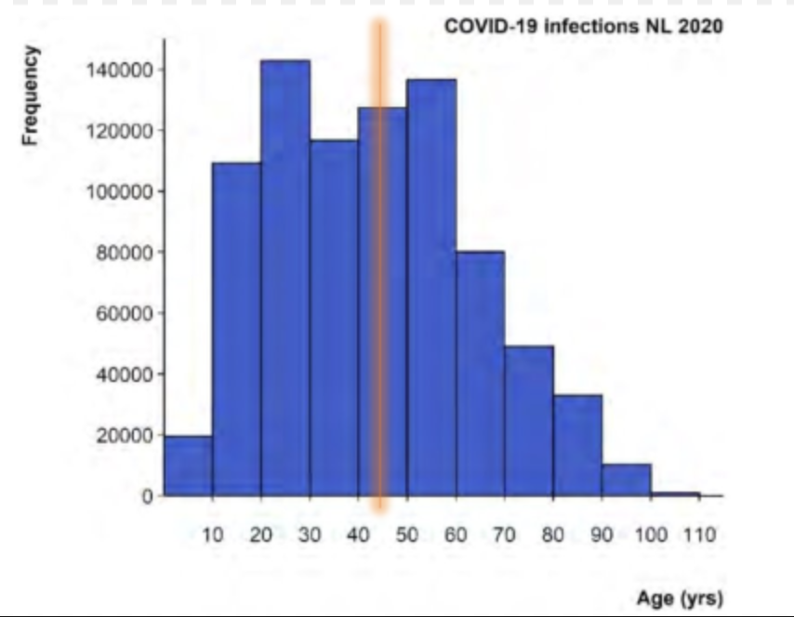
Content Knowledge Recap: Histogram
Go back to the original slide
How to analyse and interpret a histogram:
The mean age (roughly 43 years) is along the horizontal axis and can be depicted by a vertical line that crosses the horizontal axis at 43 years; the balance point of the graph.
This can also be estimated by multiplying the midrange of each bin by the height of the bar, summing these products, and then dividing by the sum of the frequencies.

Slide 60
Knowledge Recap: Case-value Plots
Go back to the original slide
Notes:
Slide 62-63

Slide 61
Content Knowledge Recap: Case-value Plots
A Case-Value Plot (CVP) is another type of graph with bars in which each bar’s height represents one measured value. In a case-value plot with nominal data on the horizontal axis and numerical data on the vertical axis (two measured variables), the relevant measured value is on the vertical axis and variability can be seen as variation in the heights of the bars.
Why do we use CVPs?
To visually compare measurements of nominal data
Comparing means of categories [=nominal data] by case
To see the variations between individual measurements
Go back to the original slide

Slide 62
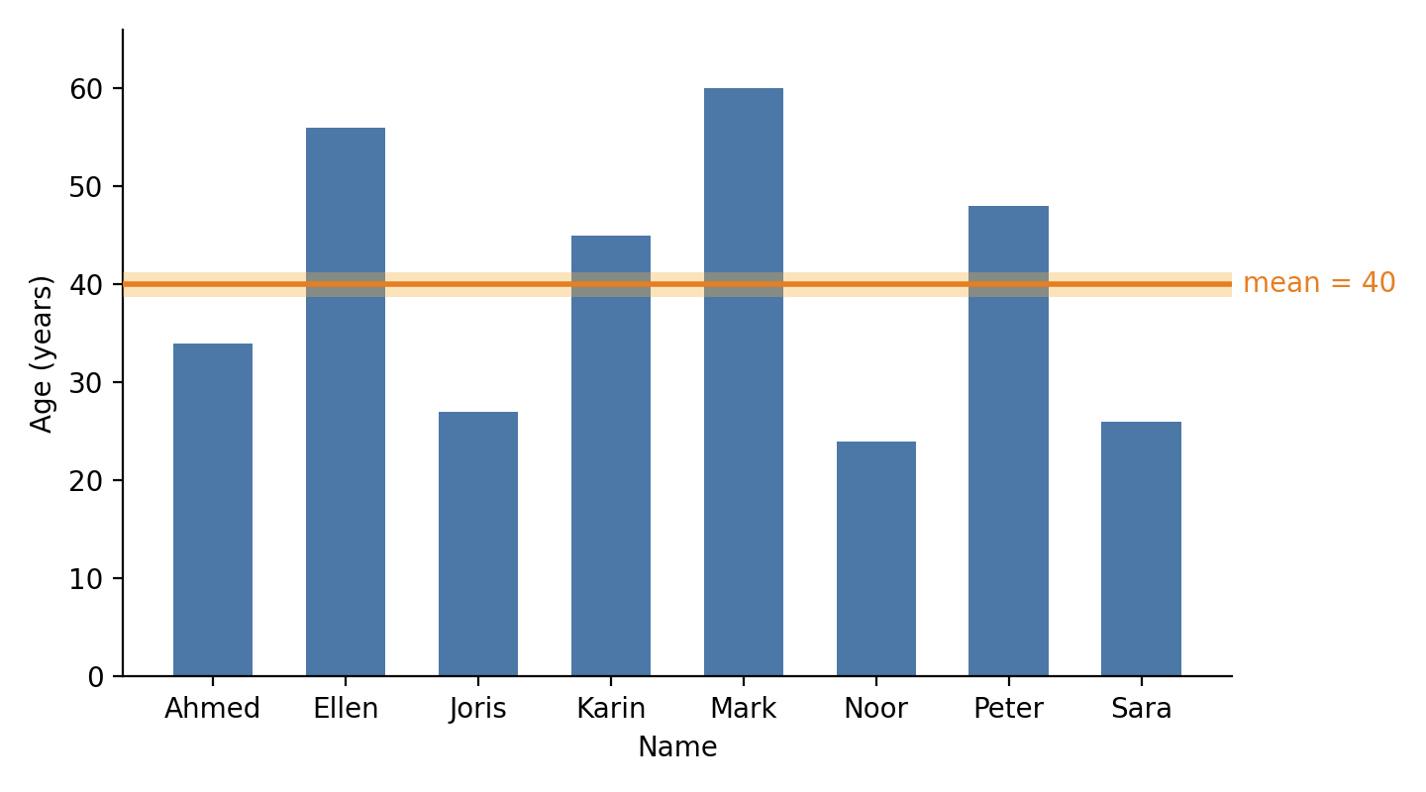
Content Knowledge Recap: Case-value Plots
Example:
This case-value plot depicts the ages of the eight teachers in the mathematics department of a school. Each bar represents one teacher.
The mean age can be depicted by a horizontal line at 40 years, crossing the vertical axis at that number.
For the mean, the empty (white) space between the line and the shorter bars is exactly as large as the parts of the taller bars that rise above the line. If you moved the parts above the line into the gaps below it, all bars would become equally high.
Go back to the original slide

Slide 63
Knowledge Recap: Boxplots
Go back to the original slide
Notes:
Slide- 64-65

Slide 64
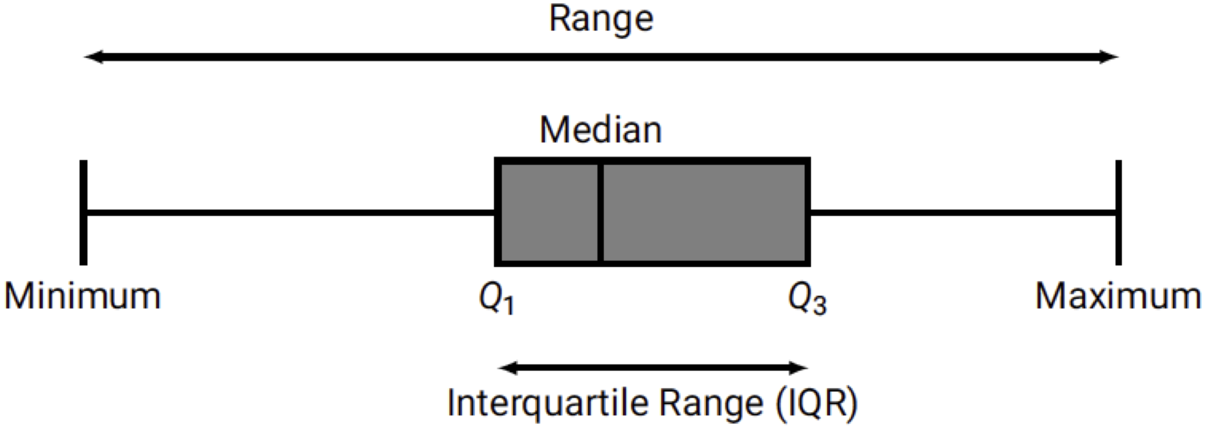
Content Knowledge Recap: Boxplots
A boxplot, also known as a box-and-whisker plot, is a graphical representation that provides a concise summary of the distribution of a dataset. It effectively displays key statistical measures in a visually intuitive manner. By showcasing these measures, boxplots offer valuable insights into the central tendency, variability, and skewness of the data. At its core, a boxplot consists of five main components: the median, the first quartile (Q1), the third quartile (Q3), the interquartile range (IQR), the extremes (maximum and minimum) and the range.
By combining these components, a boxplot offers a clear and concise summary of the distribution, and it is particularly useful for comparing the distributions of multiple datasets simultaneously, facilitating quick and effective data analysis and interpretation. In summary, a boxplot serves as a powerful tool in exploratory data analysis; whether used in statistical research, data visualization, or decision-making processes, boxplots are indispensable for understanding the distributional properties of data.
Go back to the original slide

Slide 65
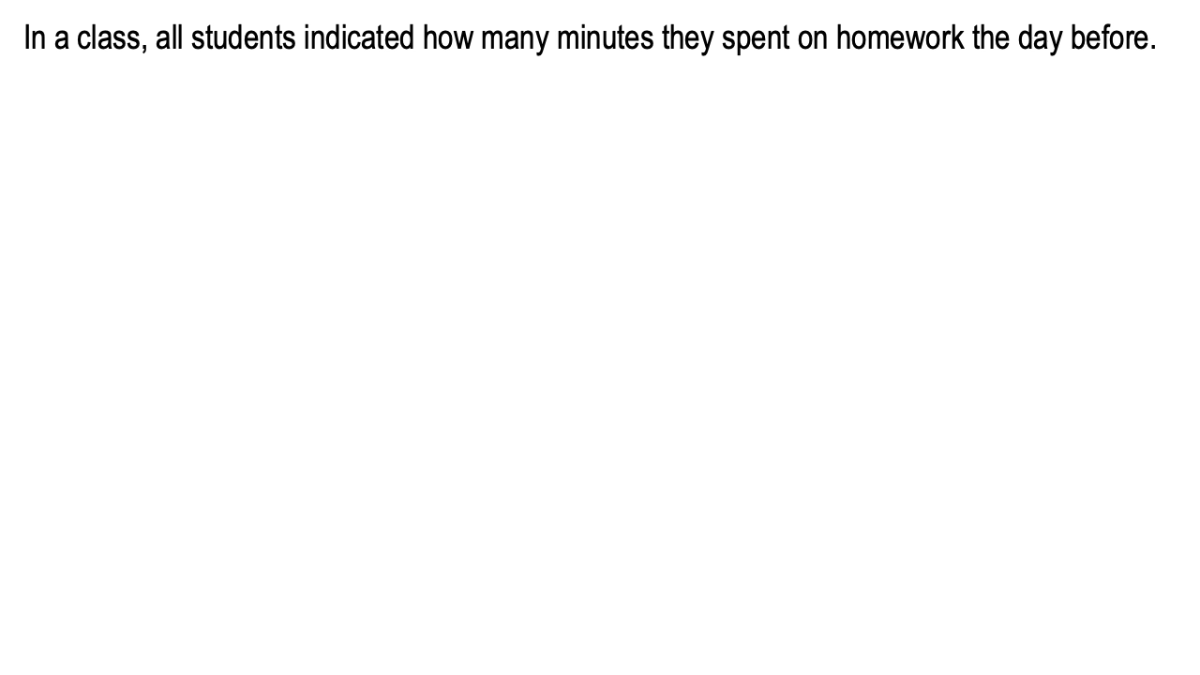
Content Knowledge Recap: Boxplots
Go back to the original slide

Slide 66
APPENDIX

Slide 67
Eye-Teach-Stats in Context
Eye-Teach-Stats is an Erasmus+ project supporting pre- and in-service mathematics teachers in recognising and responding to students’ systematic errors in statistical graph interpretation.
The course builds on eye-tracking research conducted by the project partners with primary and secondary school students, focusing on students’ conceptions and difficulties when interpreting and comparing statistical graphs (Abt et al., 2023, 2024, 2025; Boels et al., 2019a, 2019b, 2023, 2025; Schreiter & Vogel, 2022, 2023a, 2023b, 2024).
The training consists of five modules: eye-tracking information, dotplots, histograms, case-value plots, and boxplots, and is disseminated in English, German, and Dutch.
Project partners:
Heidelberg University of Education (lead), HU University of Applied Sciences Utrecht, KU Leuven, University of Education Freiburg, and University of Education Schwäbisch Gmünd.
More information: www.eye-teach-stats.eu

Slide 68














Project Team
Markus Vogel, Ayline Heursen
Saskia Schreiter
Wim Van Dooren
Lonneke Boels, Vuslat Şeker, Anita Alexander

Slide 69



Disclaimer & License
The ‘Eye-teach-stats’ project (2023-1-DE03-KA220-SCH-000158223) is funded by the European Union. Views and opinions expressed are, however, those of the authors only and do not necessarily reflect those of the European Union or the National Agency. Neither the European Union nor the granting authority can be held responsible for them.
Teaching Modules © 2026 by Eye-Teach-Stats Project is licensed under CC BY-SA 4.0. To view a copy of this license, visit creativecommons.org/licenses/by-sa/4.0/

Slide 70
References
Abt, M., Reinhold, F., & Van Dooren, W. (2023). Revealing cognitive processes when comparing box plots using eye-tracking data—A pilot study. In M. Ayalon, B. Koichu, R. Leikin, L. Rubel, & M. Tabach (Eds.), Proceedings of the 46th Conference of the International Group for the Psychology of Mathematics Education (Vol. 2, pp. 11–18). PME.
Abt, M., Leuders, T., Loibl, K., Strohmaier, A. R., Van Dooren, W., & Reinhold, F. (2024). How can eye-tracking data be used to understand cognitive processes when comparing data sets with box plots? Frontiers in Education, 9, Article 1425663. https://doi.org/10.3389/feduc.2024.1425663
Abt, M., Loibl, K., Leuders, T., Van Dooren, W., & Reinhold, F. (2025). Understanding student errors in comparing data sets with boxplots. Educational Studies in Mathematics, 120, 169–193. https://doi.org/10.1007/s10649-025-10387-z
Boels, L., Bakker, A., & Drijvers, P. (2019a). Eye tracking secondary school students’ strategies when interpreting statistical graphs. In M. Graven, H. Venkat, A. A. Essien, & P. Vale (Eds.), Proceedings of the Forty-Third Conference of the International Group for the Psychology of Mathematics Education (Vol. 2, pp. 113–120). PME.
Boels, L., Bakker, A., & Drijvers, P. (2019b). Unravelling teachers’ strategies when interpreting histograms: An eye-tracking study. In U. T. Jankvist, M. Van den Heuvel-Panhuizen, & M. Veldhuis (Eds.), Proceedings of the Eleventh Congress of the European Society for Research in Mathematics Education (pp. 888–895). Freudenthal Group & Freudenthal Institute, Utrecht University, and ERME.
Boels, L., Lyford, A., Bakker, A., & Drijvers, P. (2023). Assessing students’ interpretations of histograms before and after interpreting dotplots: A gaze-based machine learning analysis. Frontline Learning Research, 11(2), 1–30. https://doi.org/10.14786/flr.v11i2.1139
Boels, L., Bakker, A., Van Dooren, W., & Drijvers, P. (2025). Secondary school students’ strategies when interpreting histograms and case-value plots: An eye-tracking study. Educational Studies in Mathematics, 118(3), 479–503. https://doi.org/10.1007/s10649-024-10351-3
Schreiter, S., & Vogel, M. (2022). Drawing inference from data when comparing groups: An eye-tracking study. In C. Fernández, S. Llinares, A. Gutiérrez, & N. Planas (Eds.), Proceedings of the 45th Conference of the International Group for the Psychology of Mathematics Education (Vol. 4, p. 285). PME.
Schreiter, S., & Vogel, M. (2023a). Eye-tracking measures as indicators for a local vs. global view of data. Frontiers in Education, 7, Article 1058150. https://doi.org/10.3389/feduc.2022.1058150
Schreiter, S., & Vogel, M. (2023b). Statistical thinking and viewing patterns when comparing data distributions: An eye-tracking study with 6th and 8th graders. In M. Ayalon, B. Koichu, R. Leikin, L. Rubel, & M. Tabach (Eds.), Proceedings of the 46th Conference of the International Group for the Psychology of Mathematics Education (Vol. 4, pp. 179–186). PME.
Schreiter, S., & Vogel, M. (2024). Students’ local vs. global views of data distributions: A cross-grade-level analysis using eye-tracking. Educational Studies in Mathematics. https://doi.org/10.1007/s10649-024-10352-2
For a list of publications in the project, please click: https://eye-teach-stats.eu/publications/

